Slide 1
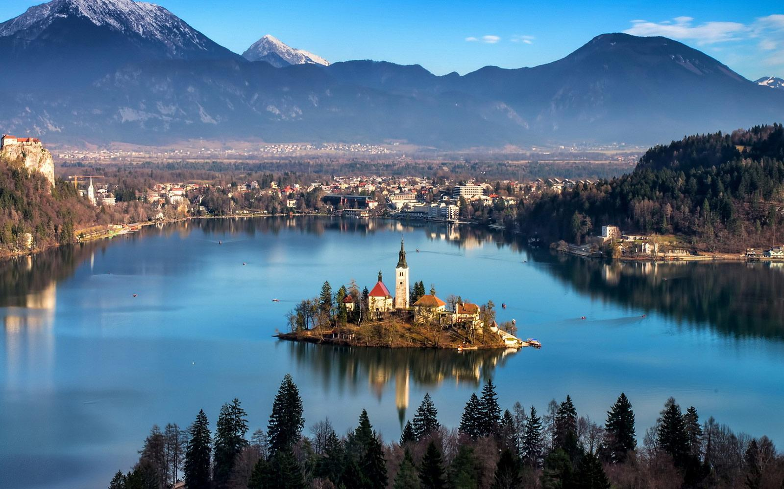
HOW WELL DO YOU KNOW SLOVENIA?

Slide 2
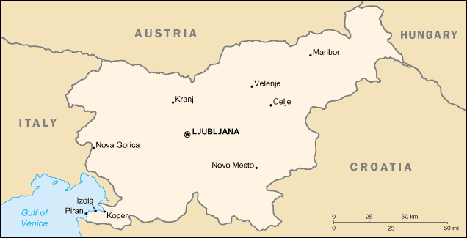
1. Name the countries bordering Slovenia
Italy, Croatia, Austria, Hungary
Italy, Germany, Switzerland, Croatia
Germany, Italy, Austria, Hungary

Slide 3
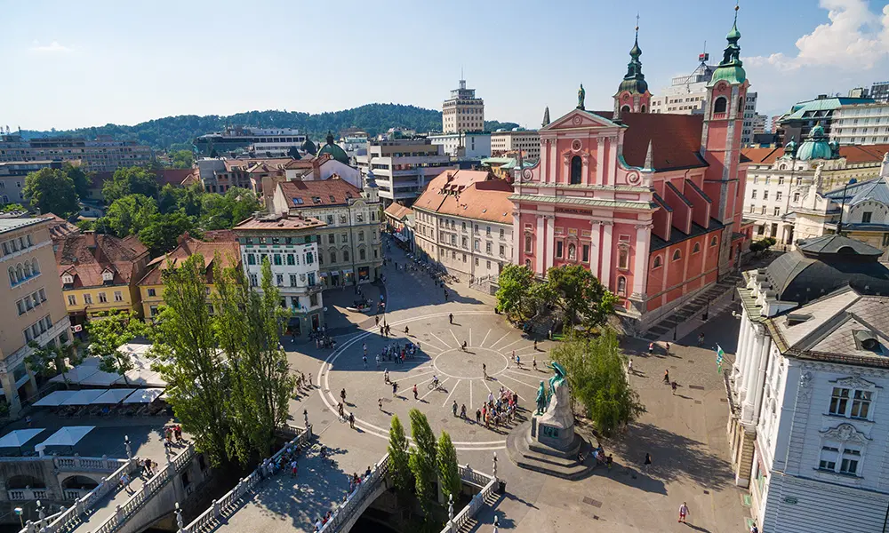
2.What is the capital city of Slovenia?
Koper
Maribor
Ljubljana
Ljubljana

Slide 4
3.How many people are there in Slovenia?
1.5 millions
2 millions
3 millions

Slide 5
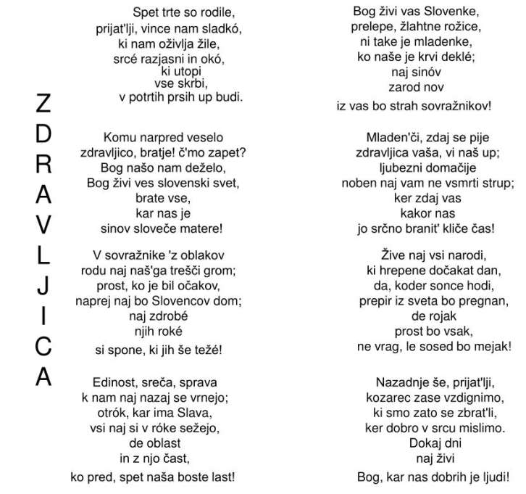
4.What is the name of our national anthem?
Na zdravje
Zdravljica
Domovini

Slide 6
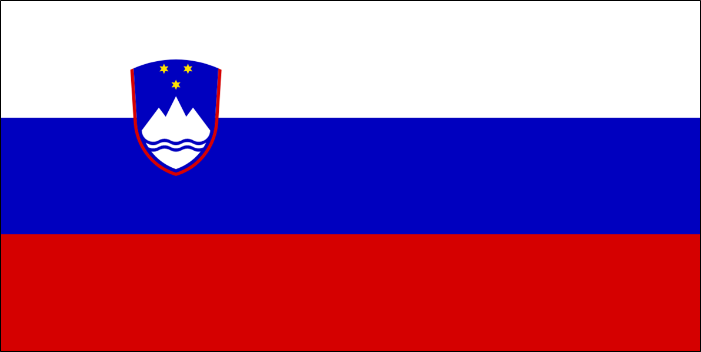
5.Which are the colours of the Slovene flag?
White, blue, yellow
White, blue, red
Blue, red, green

Slide 7
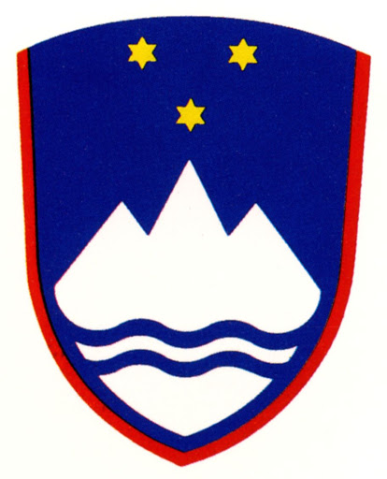
6.Which symbols can be found on the Slovene flag?
the eagle, the 3 stars, the mountain
the sun, the 3 stars, the river
the river, the 3 stars, the mountain

Slide 8
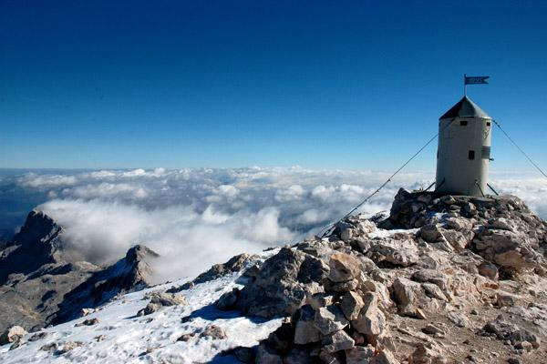
7.Which is the highest mountain in Slovenia?
Vršič
Triglav
Šmarna gora
Triglav

Slide 9
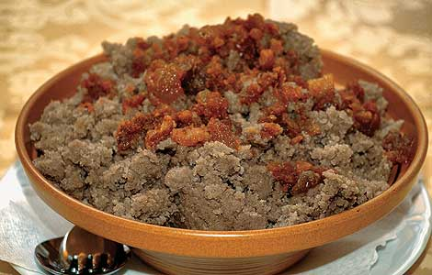
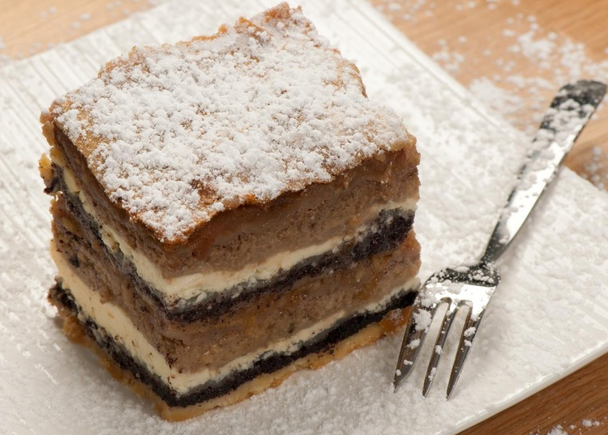
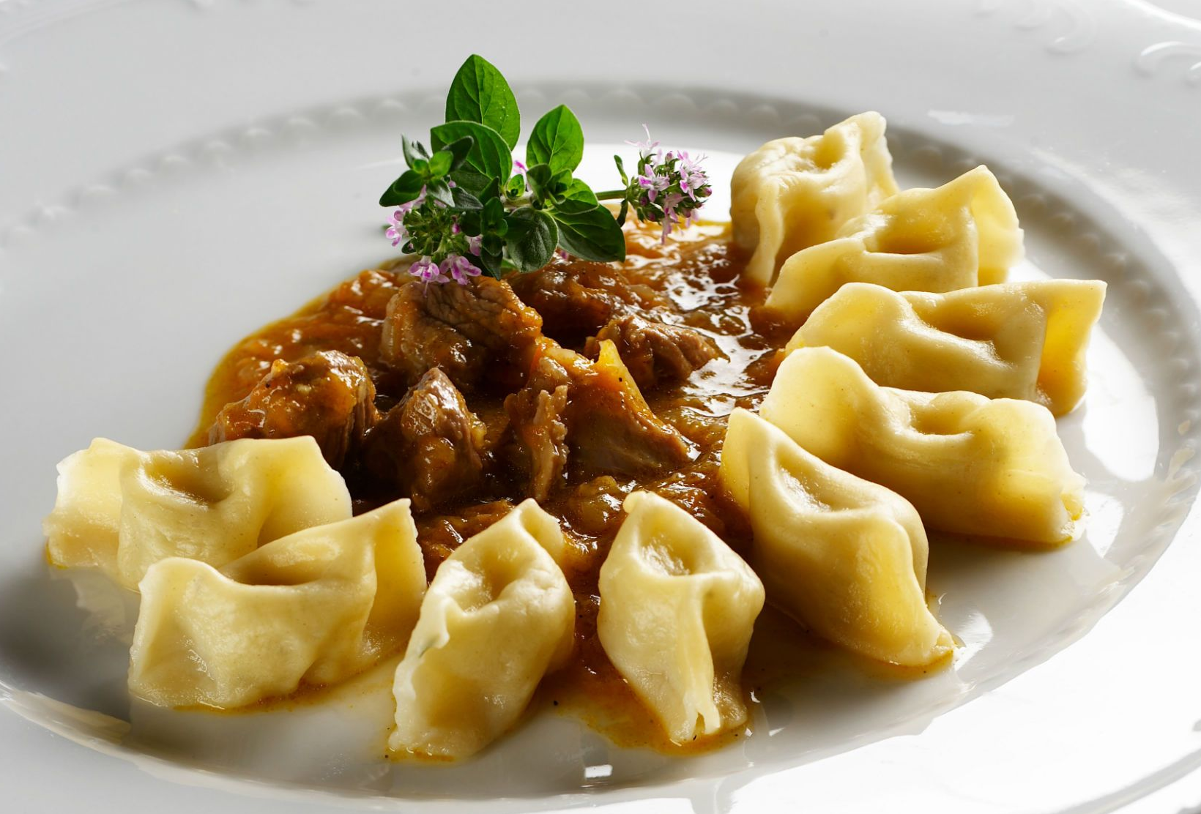
8.Name 3 traditional Slovene dishes
ajdovi žganci, prekmurska gibanica, idrijski žlikrofi
pasta, pizza, smoked ham
cheeseburger, nachos, hot dog

Slide 10
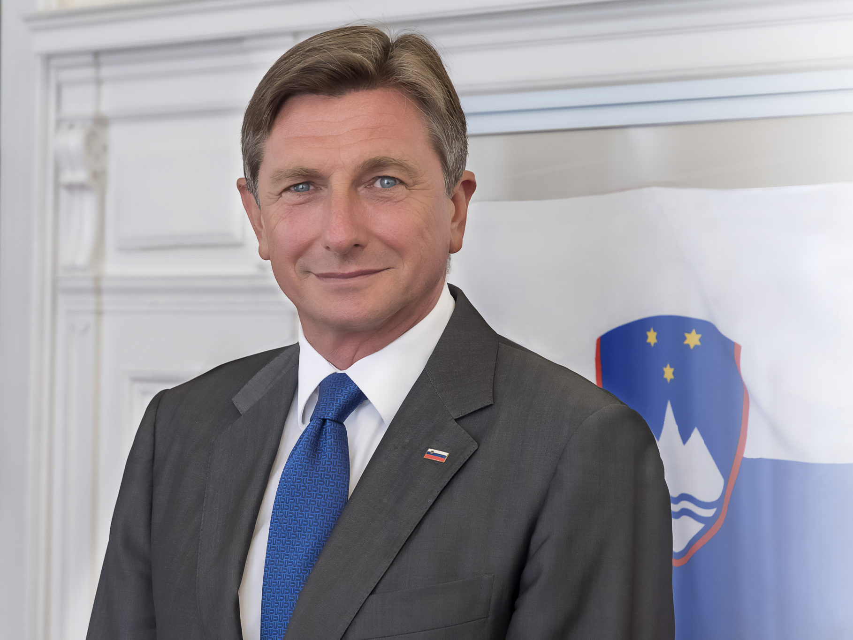
9.Who is the president of Slovenia?
Janez Janša
Borut Pahor
Janez Drnovšek
Borut Pahor

Slide 11
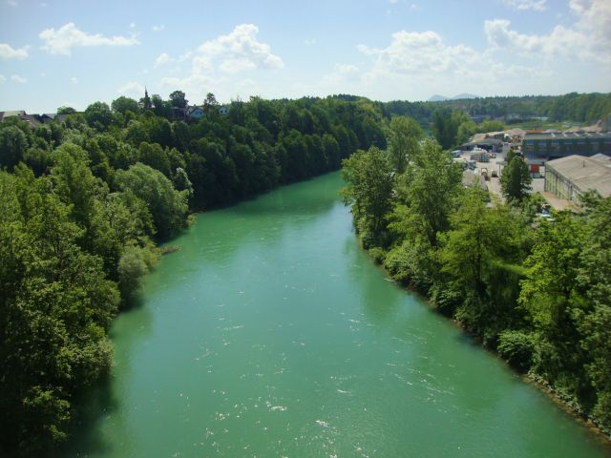
10.Which is the longest river in Slovenia?
Sava
Mura
Drava
Sava

