Slide 1
Physicochemical and biological state of selected water ecosystems in Alpine space
REPORTAGE OF THE PILOT ACTION
May 31st 2018
Teren v TNP v okviru modula Ekološke analize in monitoring
Mentorja: prof. Anita Zupanc in prof. Urška Kleč
Zunanji strokovnjak iz TNP: mag. Tanja Menegalija

Slide 2
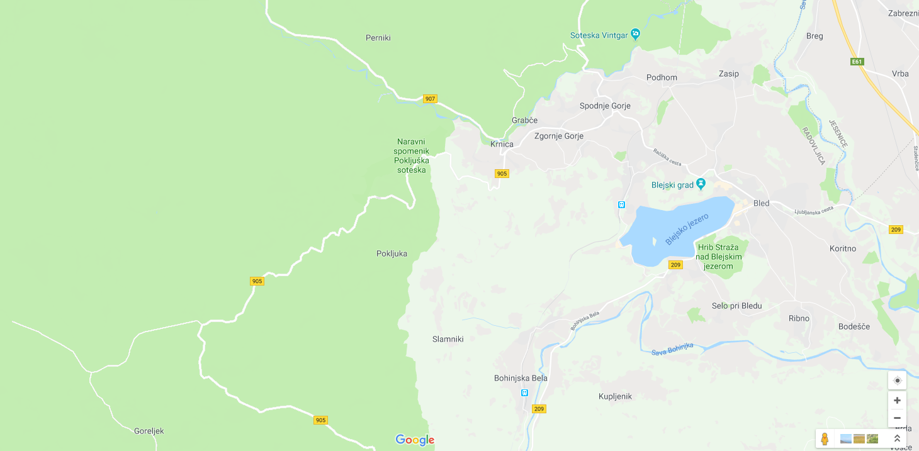
2 destinations of our pilot action on the May 31 2018
Radovna Valley
1st stop
Plateau Pokljuka
2nd stop
Goreljek
Peatbog

Slide 3
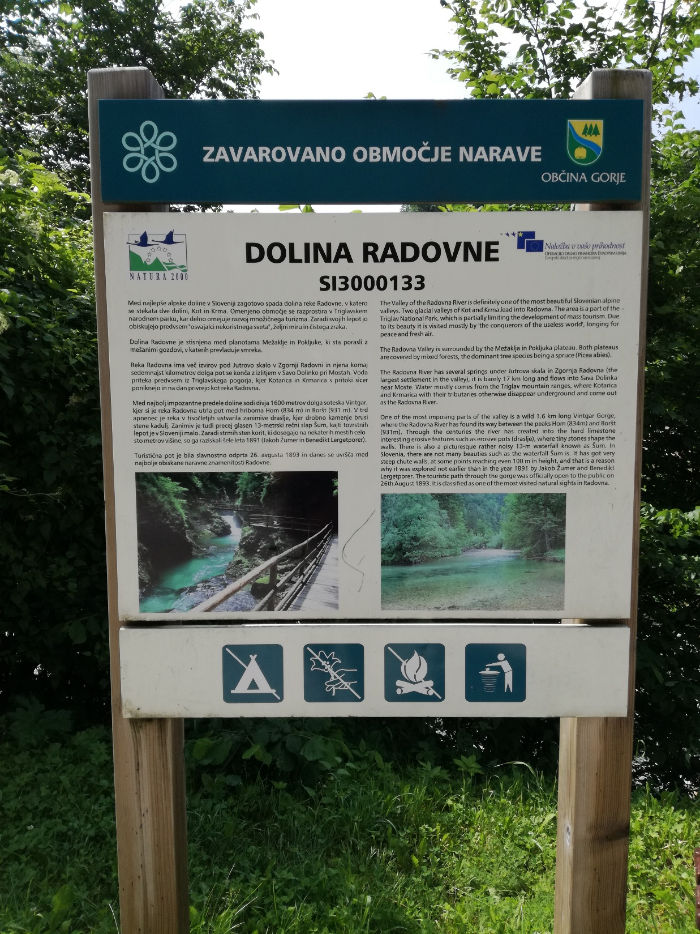
Radovna River
1st stop on our pilot action was in Grabče, Zgornje Gorje in the Natura 2000 protected valley of alpine Radovna River

Slide 4
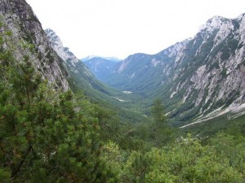
Radovna River is a part of Triglav National Park (TNP) and the same name is used for the settlement, the river, and the 20 km long valley.
The narrow valley nestles between the slopes of Mežakla and Pokljuka Plateaus and is known for its hummocky meadows. This typical formation on the floor of the valley is the result of glaciation in the valleys of Kot and Krma that lead into Radovna.
The river is barely 17 km long and flows into Sava Dolinka near settlement Moste.
One of the most imposing parts of the valley is s wild 1,6 km long Vintgar Gorge – perhaps we will visit it next time… ☺
Source: http://www.vintgar.si/wp-content/uploads/2016/06/pogledkrma-300x225.jpg

Slide 5
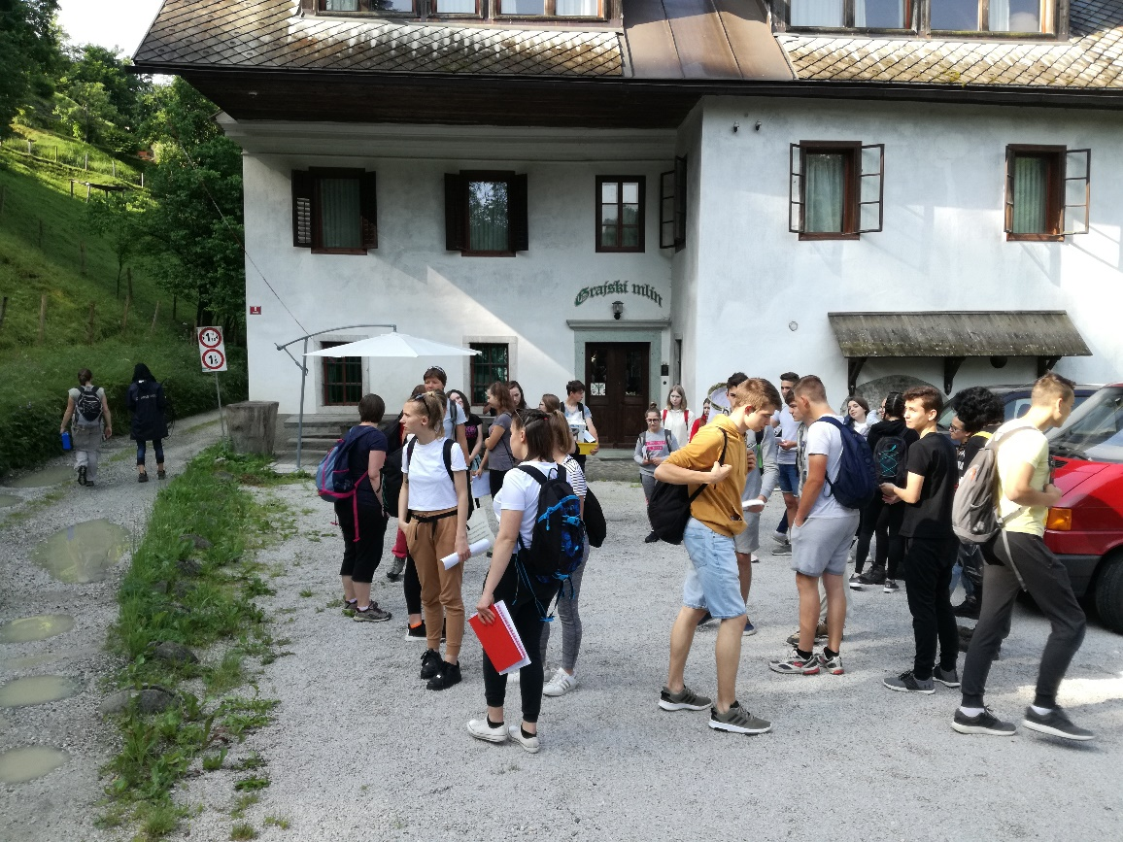
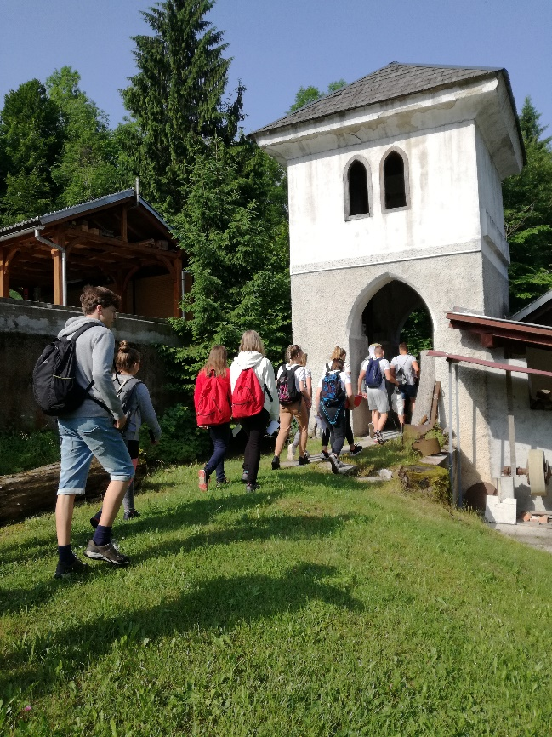
We gathered in front of the Castle‘s Mill lying on the emerald Radovna River, which dates back to year 1004.
We met with two experts, one from TNP and the other from Slovenian Environment Agency (ARSO).
We had a short lecture about Radovna River by the expert from TNP.
The expert from ARSO explained how they perform regular monitoring of inland surface and ground waters.

Slide 6
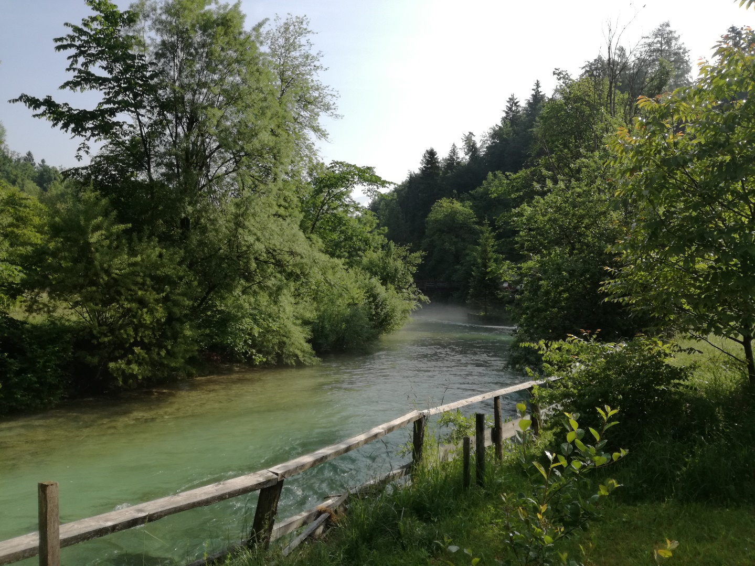
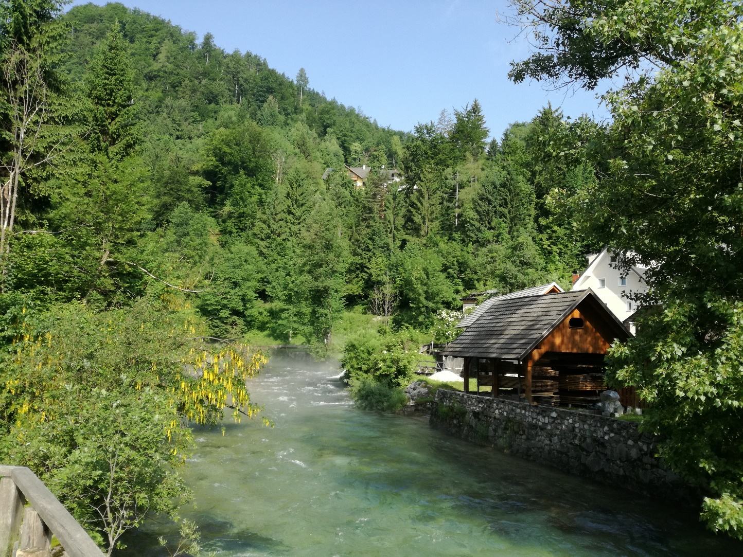
Morning view of the river and yellow flowering Laburnum alpinum
behind the Castle’s Mill was a candy for our eyes.

Slide 7
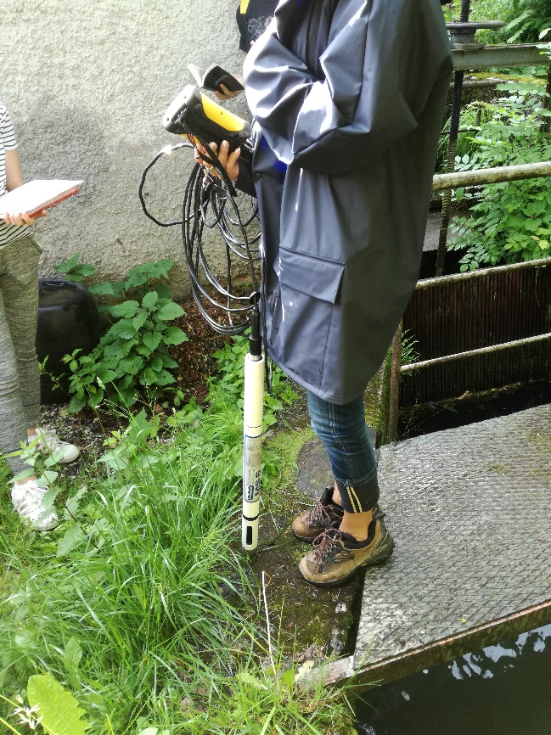
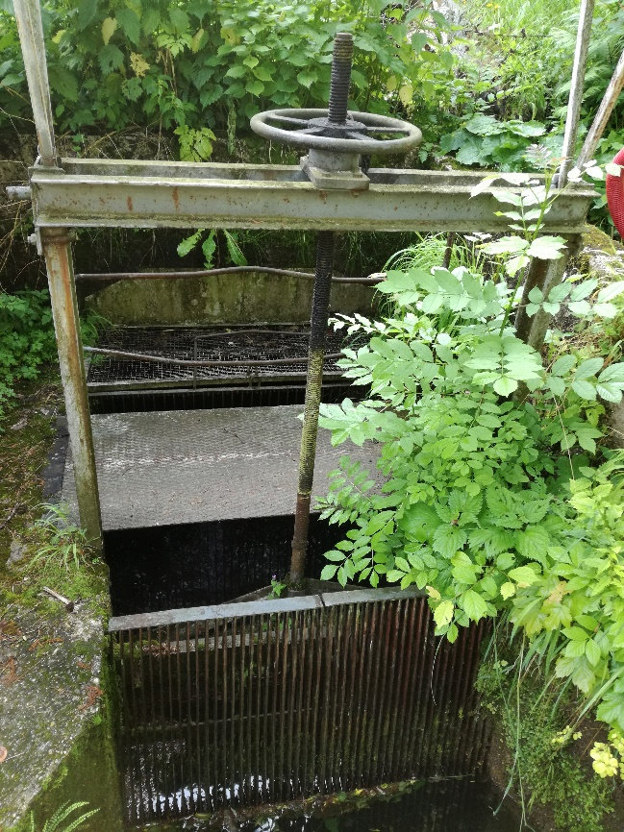
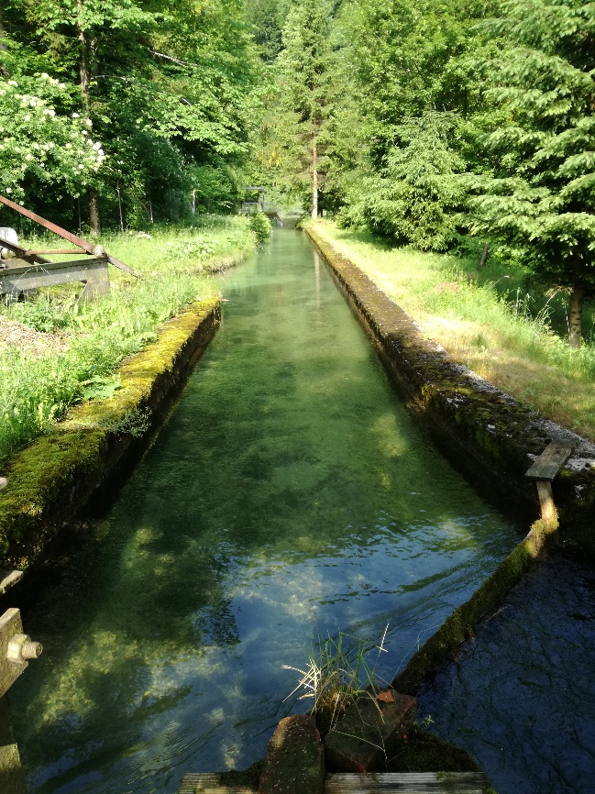
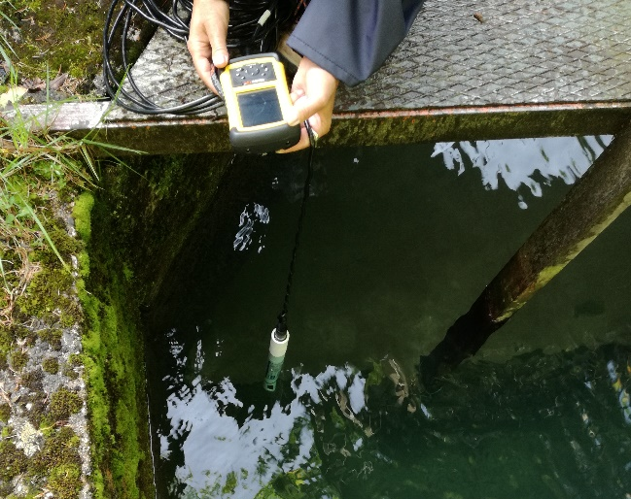
The ARSO expert performed first analysis using multifunctional sensor for:
- T
- pH
- redox potent.
- conductivity
- dissolved O₂
- O₂ saturation.
The location of the analysis was the water from Radovna River which is directed into Lake Bled, therefore its quality is monitored regularly. We learnt that the artificial connection between Radovna River and Lake Bled was established in 1960s as sanitation of heavily eutrophied lake.

Slide 8
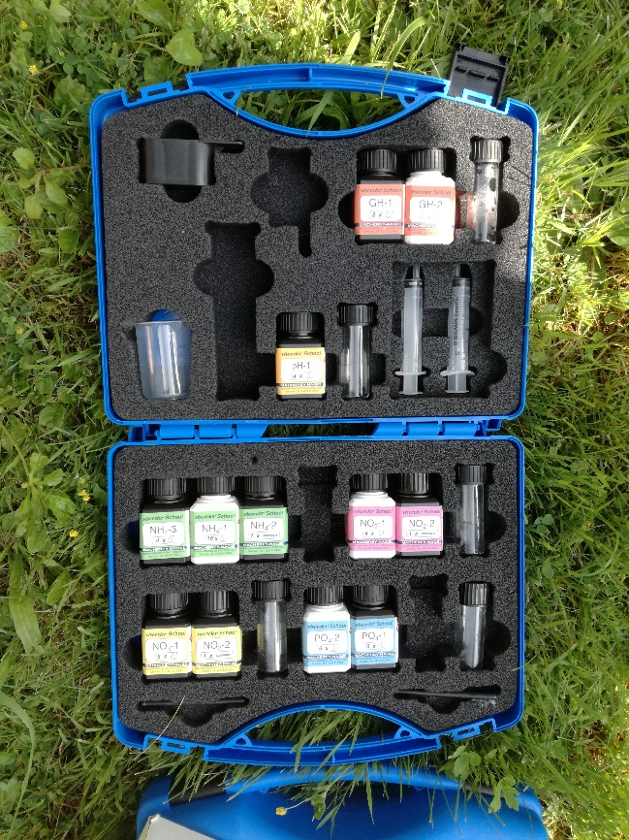
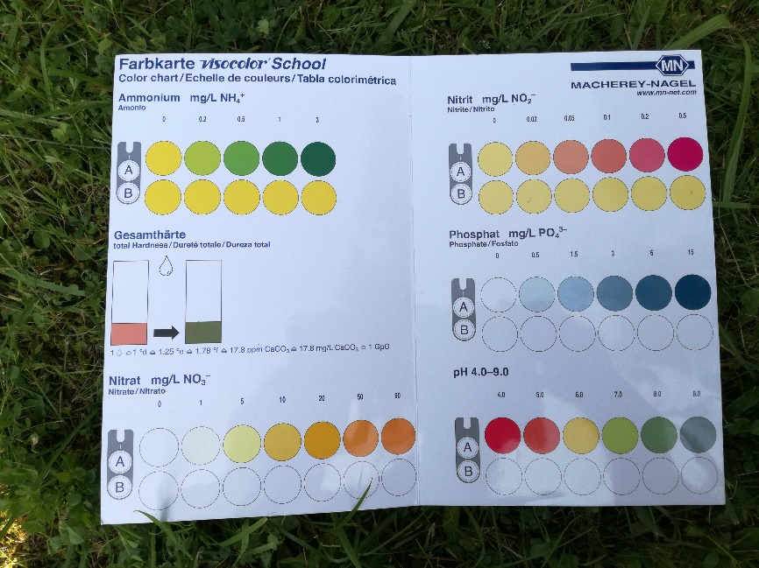
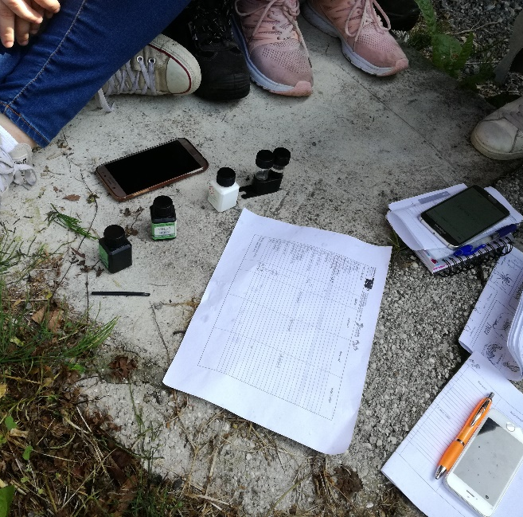
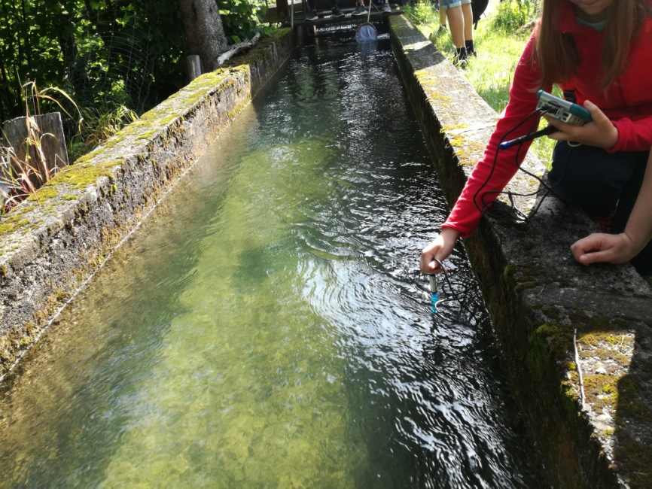
First we were introduced with physichochemical monitoring and sampling methods…
&
…did on-site analyses of the water on our own with the equipment we brought from school.
We measured:
- T
- pH
- conductivity, and
- dissolved O₂ using special electrodes,
and also
- NH₄⁺, NO₃⁻, NO₂⁻, PO₃⁴⁻ using fast qualitative tests.

Slide 9
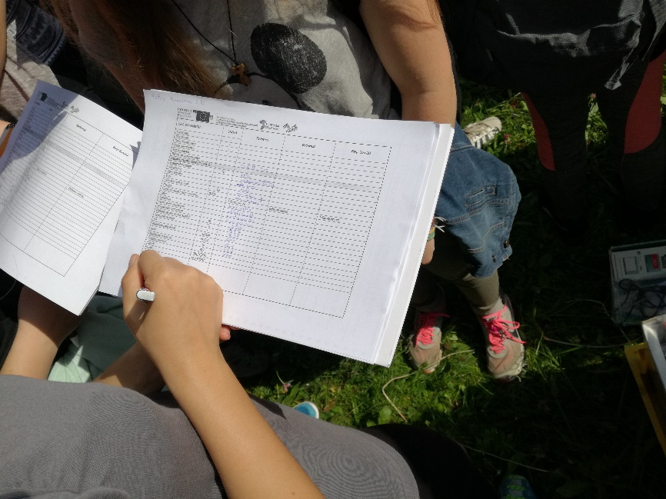
We were provided with official report table from ARSO and carefully recorded the data we acquired.
Our results:
Radovna River had an excellent chemical status at our sampling site as expected for the emerald Alpine river! ☺

Slide 10
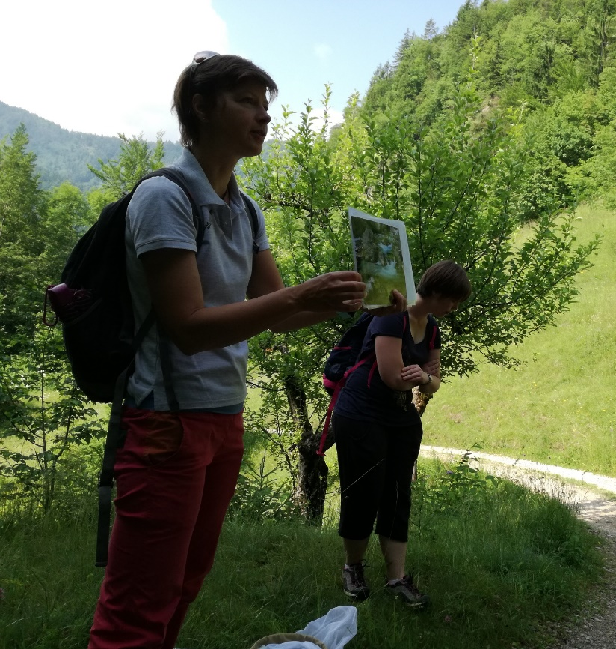
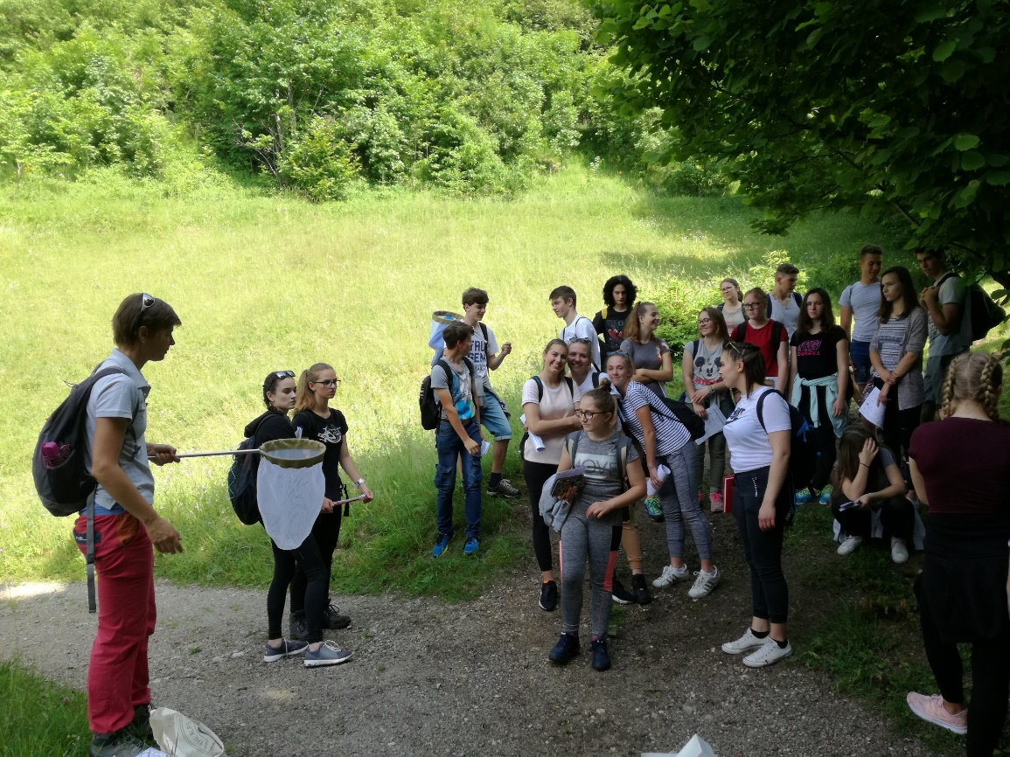
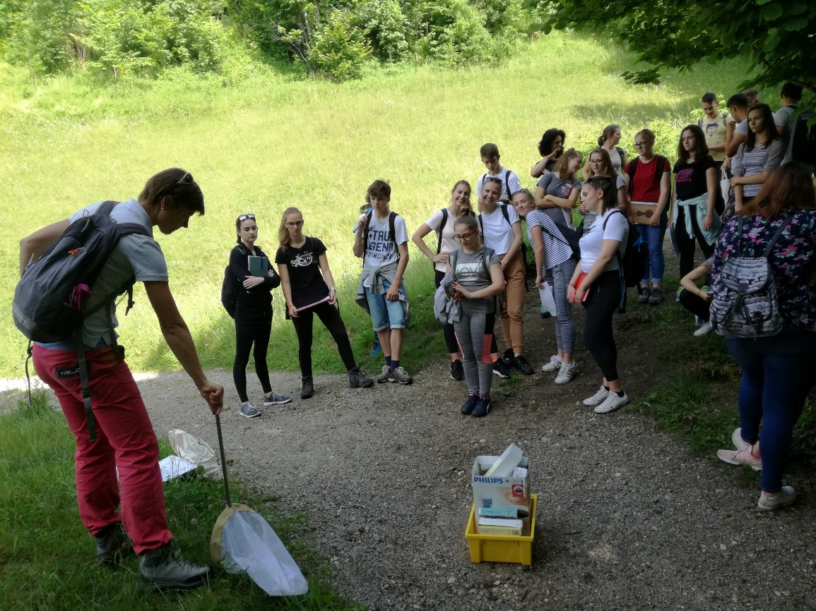
…from our 1st stop point we proceeded our hike up the valley and the TNP expert mag. Tanja Menegalija introduced us with ecological monitoring, sampling methods, and aquatic invertebrates.
demonstration of sampling techniques with catching net

Slide 11
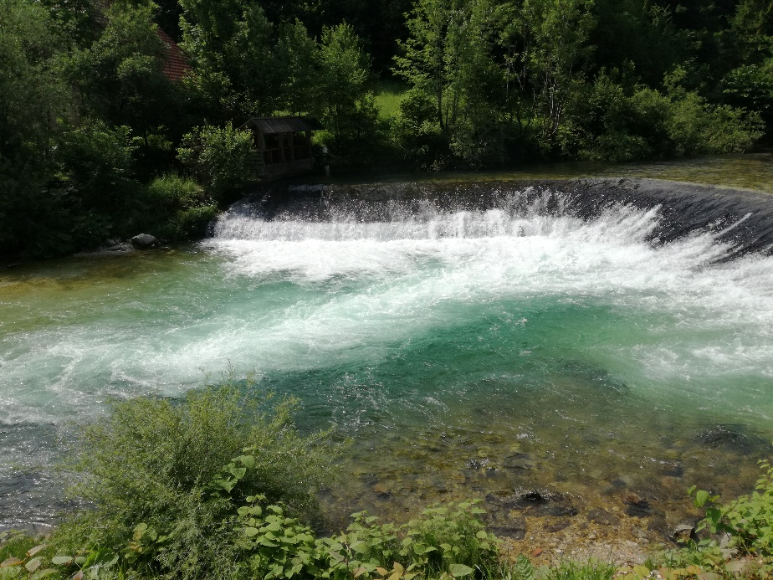
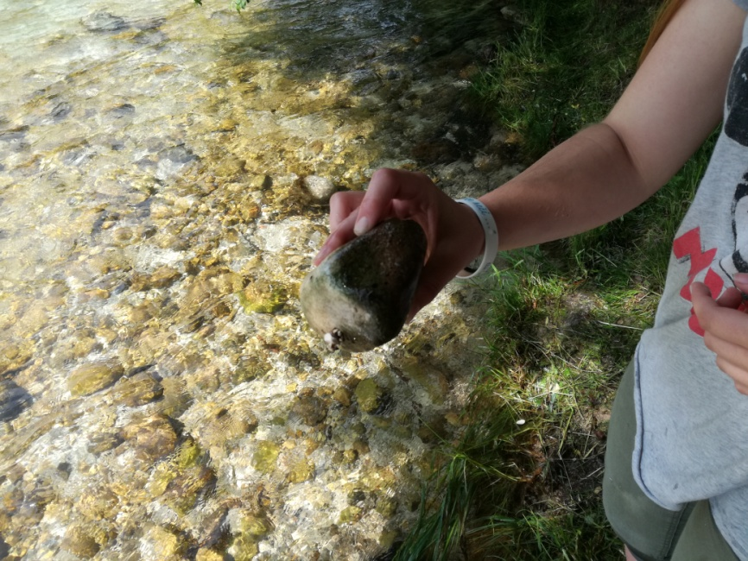
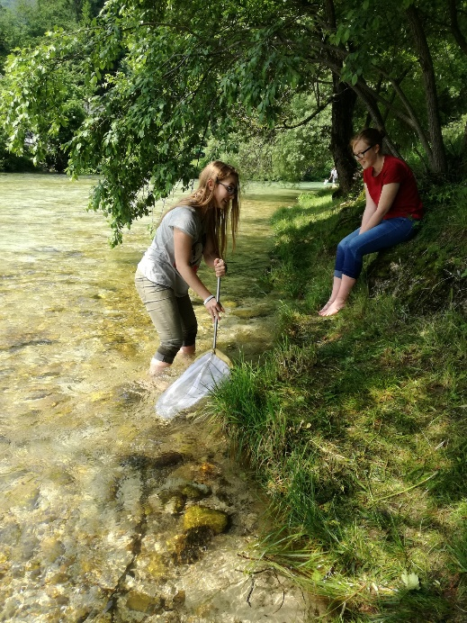
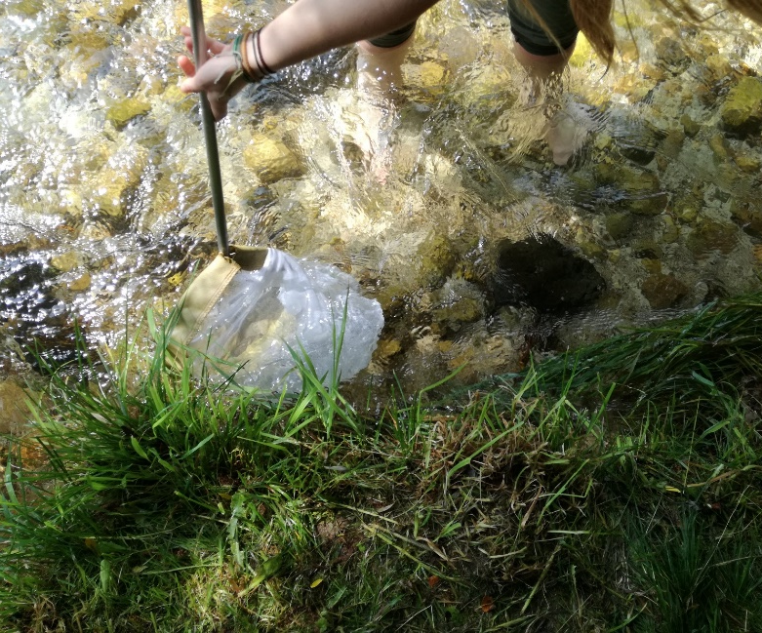
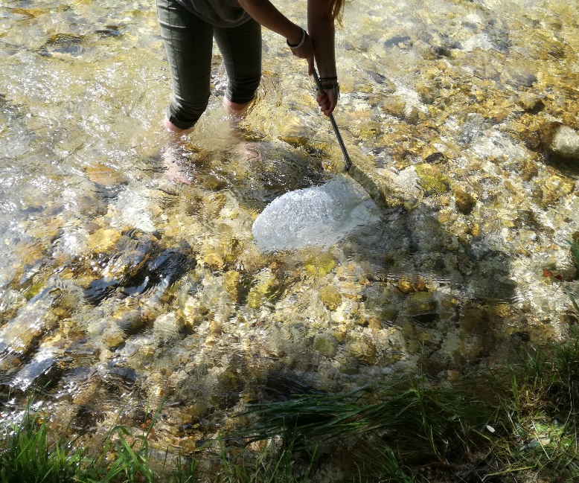
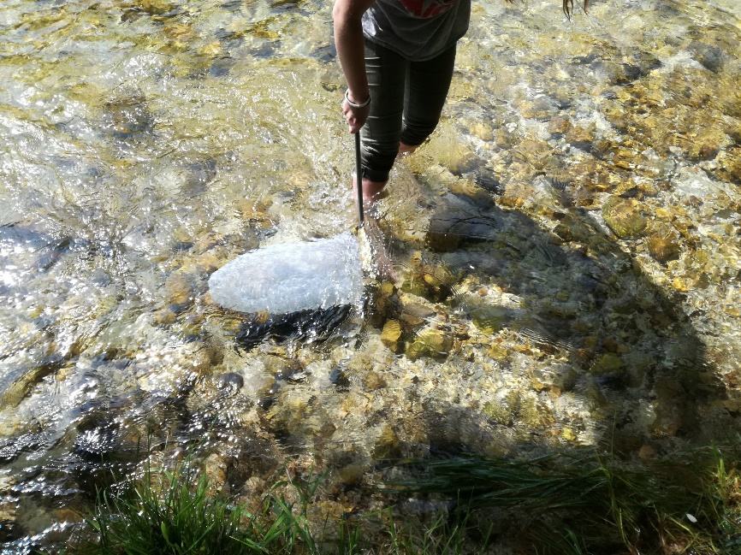
On the river bank in village Krnica we tested different sampling techniques with catching net and also gathered some stones to see what is living on them.
(The water was super cold ☺).

Slide 12
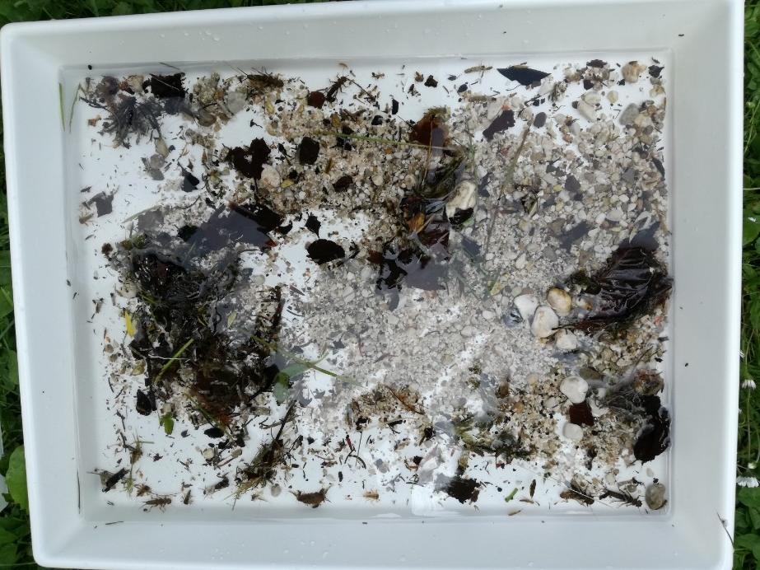
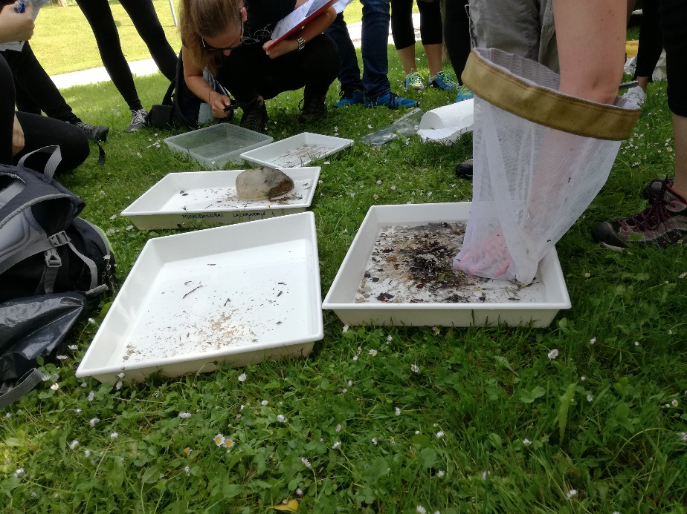
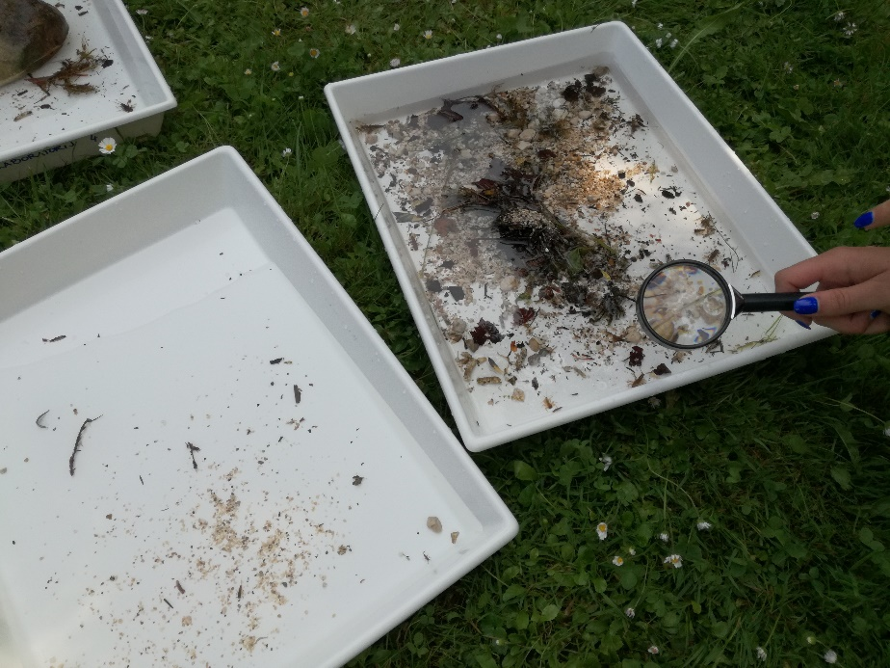
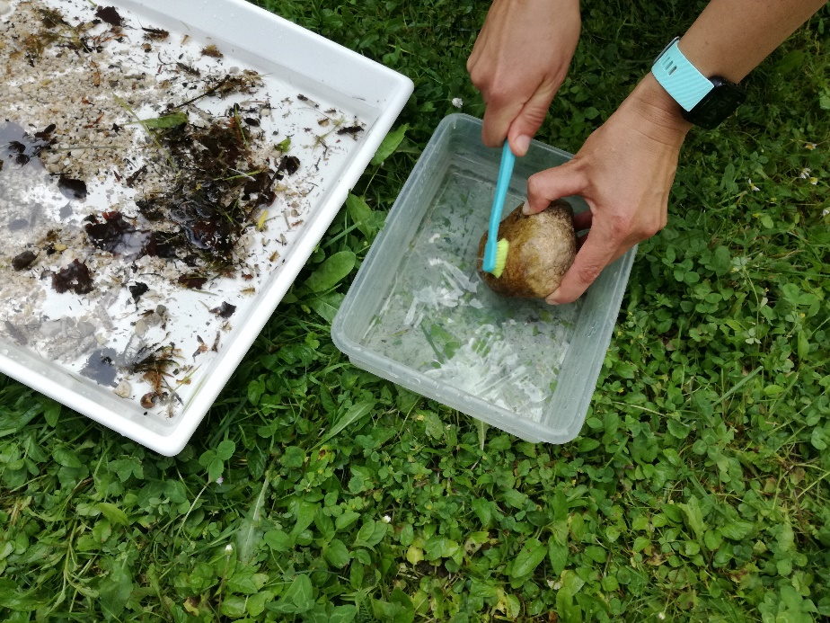
Sampled material was transferred into lab trays where we previously prepared water.
We looked for invertebrates and tried to determine them with the help of identification keys and our experts, of course ☺.

Slide 13
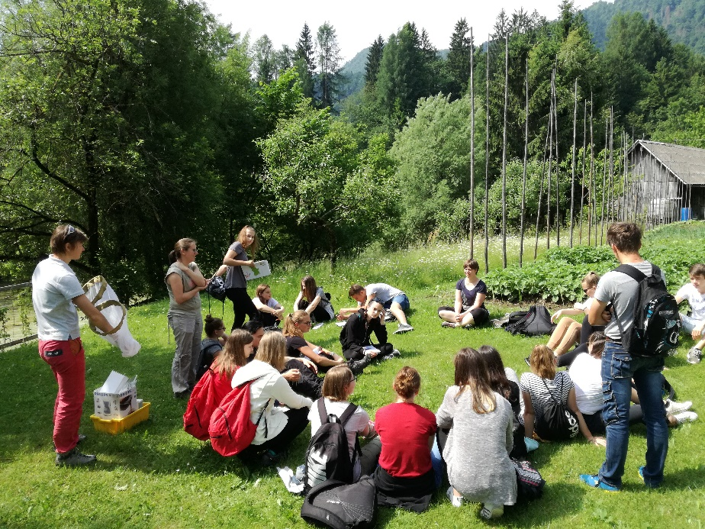
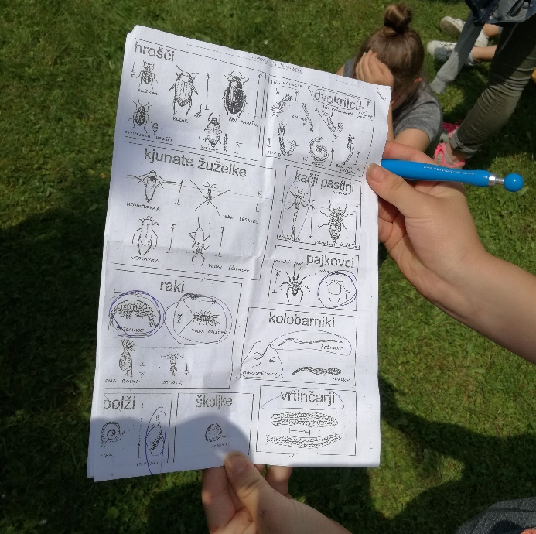
We discussed our results and concluded that Radovna River has an excellent ecological status at location of our sampling!

Slide 14
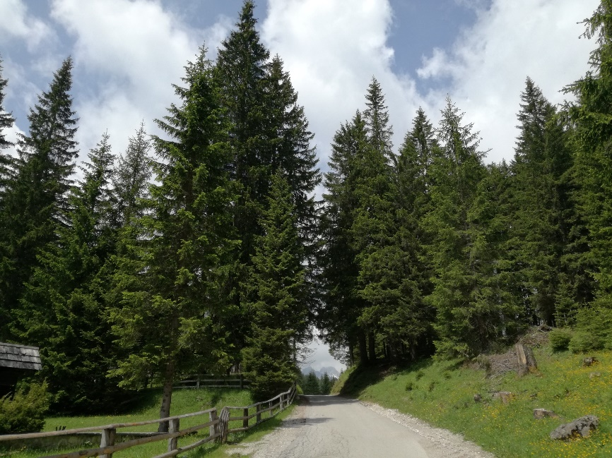
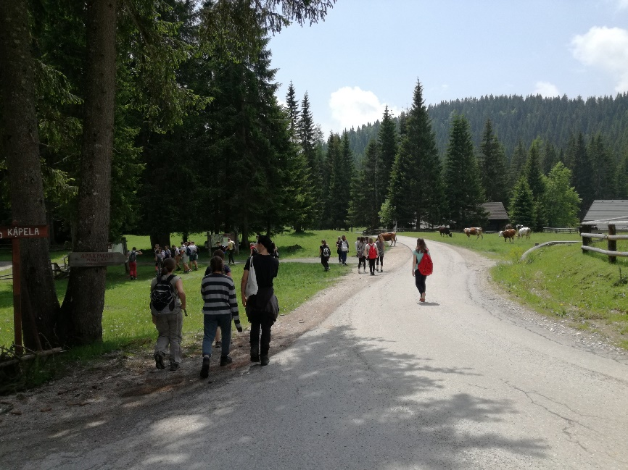
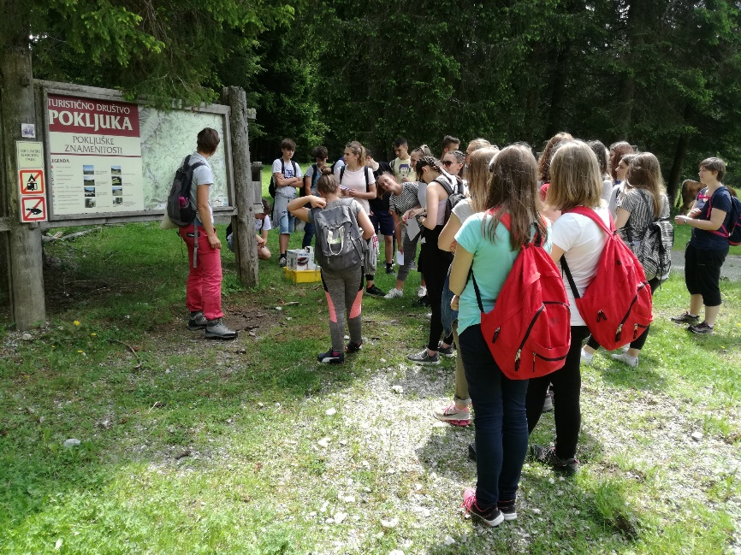
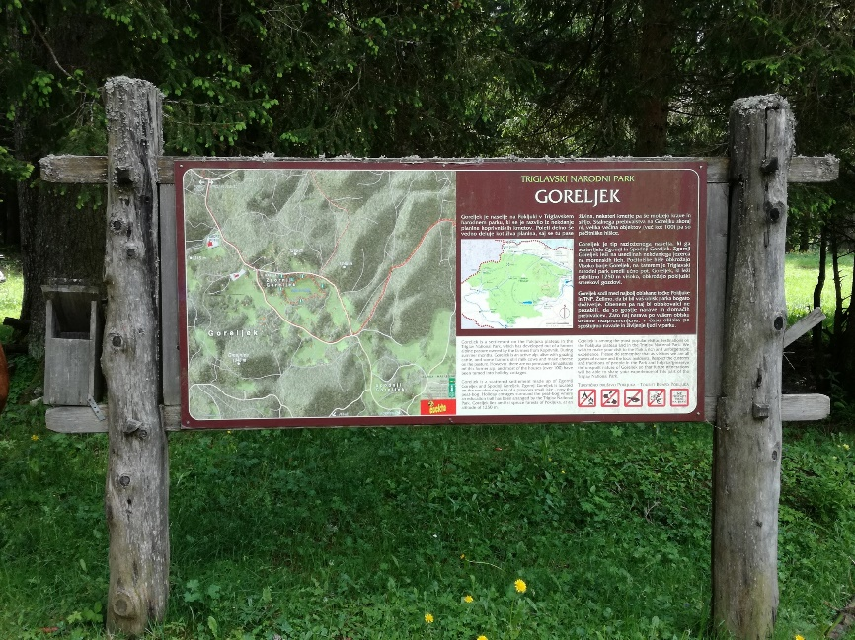
Pokljuka Plateau
2nd stop on our pilot action was Goreljek Peatbog at Goreljek, Pokljuka Plateau

Slide 15
Circular natural trail leads around the Goreljek Peatbog.
Source: Annex 3 or
https://www.tnp.si/assets/Obiscite/Aktivnosti/Parkovne-pespoti/Dokumenti/JZ-TNP-Pokljuka-in-Sotna-barja-SLO.pdf

Slide 16
Circural natural trail Goreljek Peatbog – some general information:

Slide 17
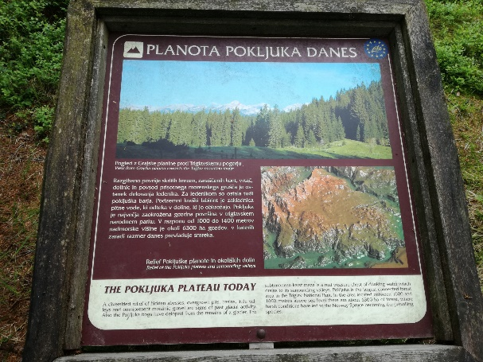
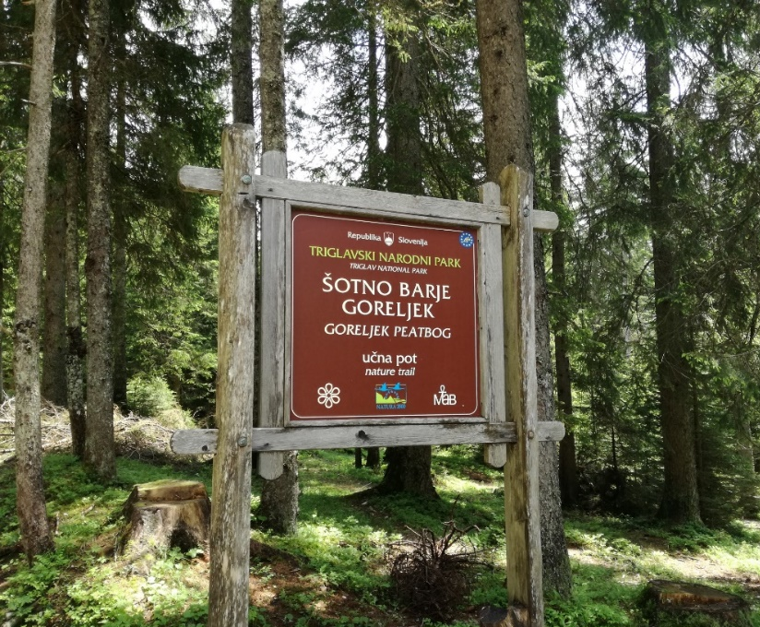
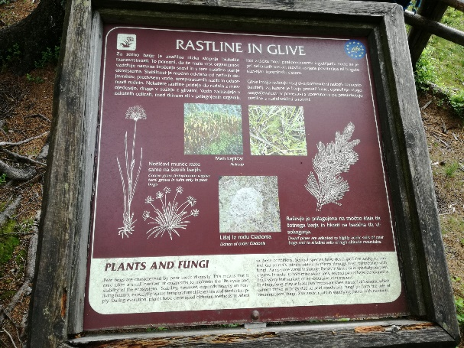
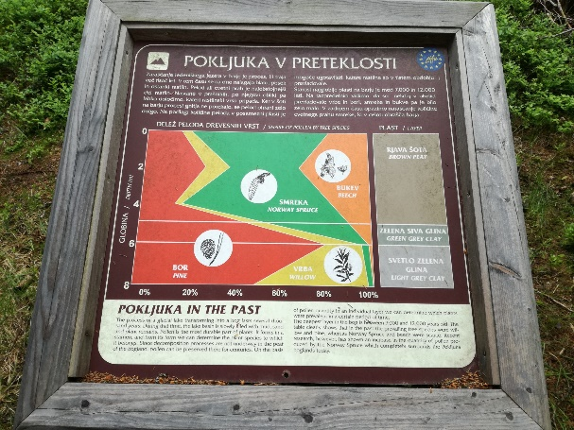
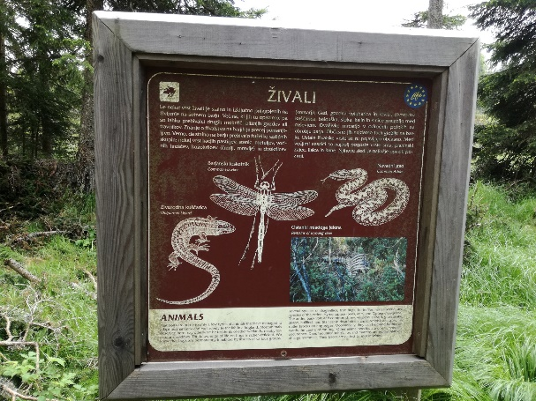
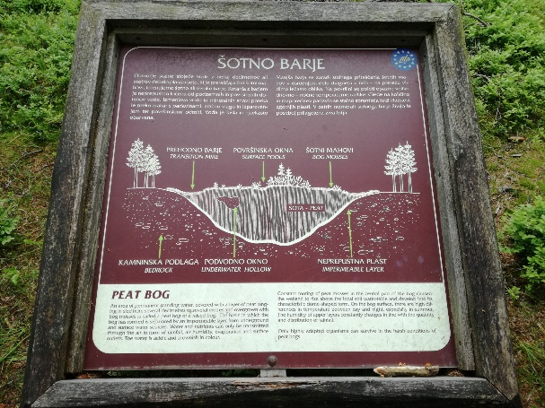
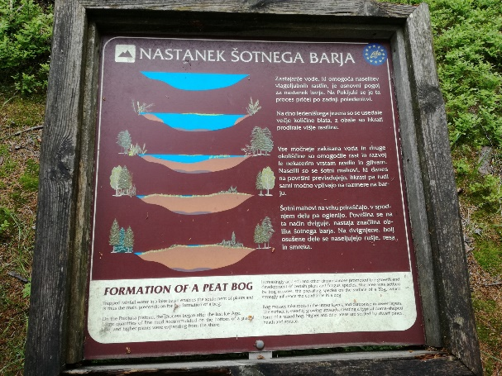
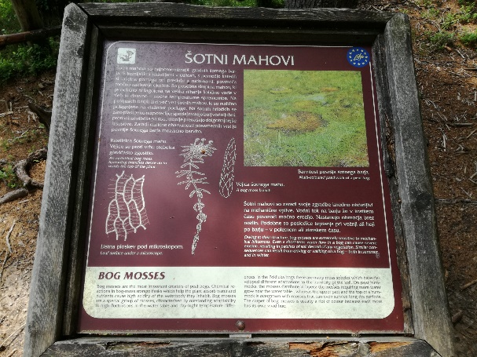
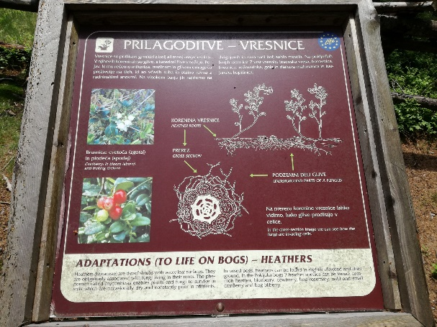
The trail is well equiped with learning boards with useful information about the peatbog flora and fauna, Pokljuka today and in the past, general characteristics of peatbogs and human activities in the surrounding areas.

Slide 18
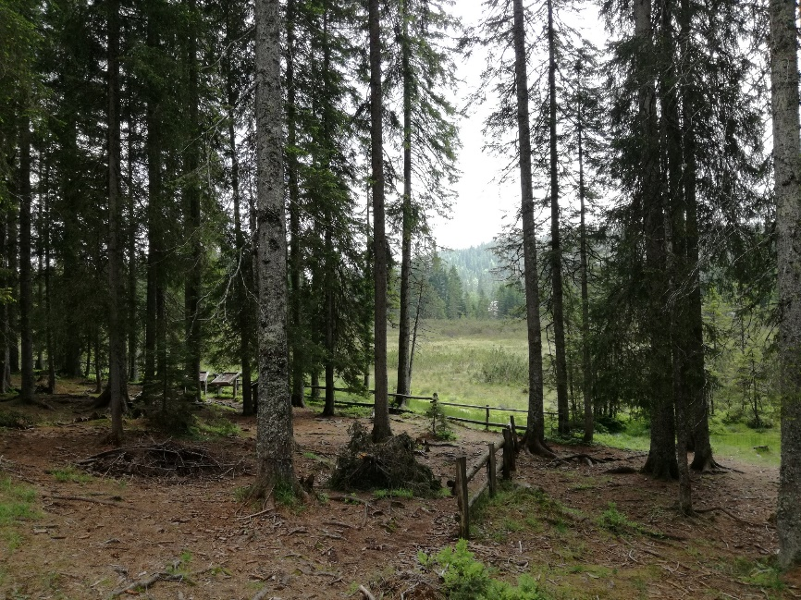
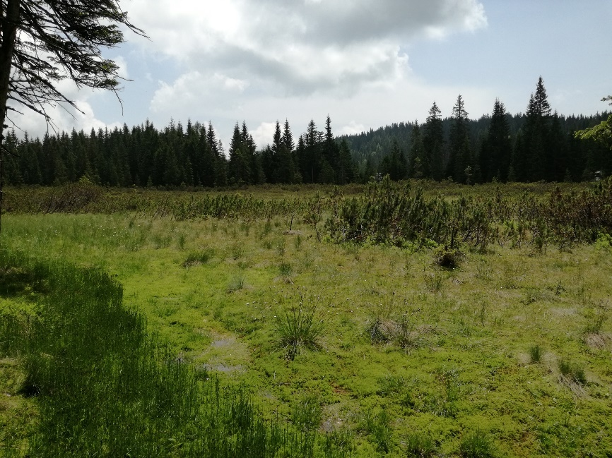
First view of the Goreljek Peatbog from the forest.
Its a special ecosystems – an area of stagnant water, covered with a layer of peat ranging in size from several decimetres to several metres and overgrown with peat mosses.
The peat bogs on the Pokljuka Plateau are the southernmost lying raised bogs in Europe.
In lower-lying areas, bogs were destroyed by drying to make agricultural land and for making firewood.
A highly sensitive ecosystem, peat bogs are protected under the EU legislation and included in the Natura 2000 network.

Slide 19
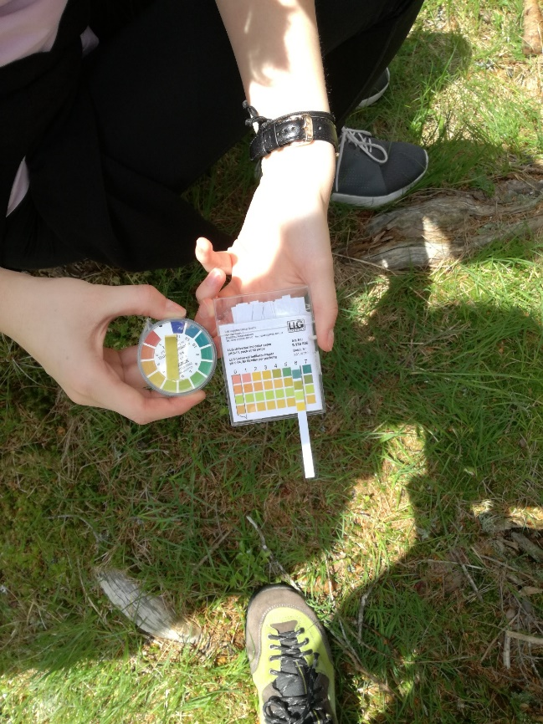
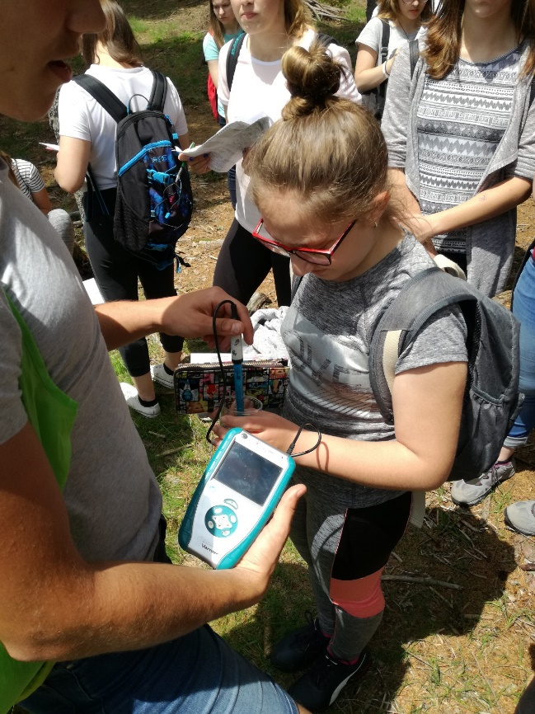
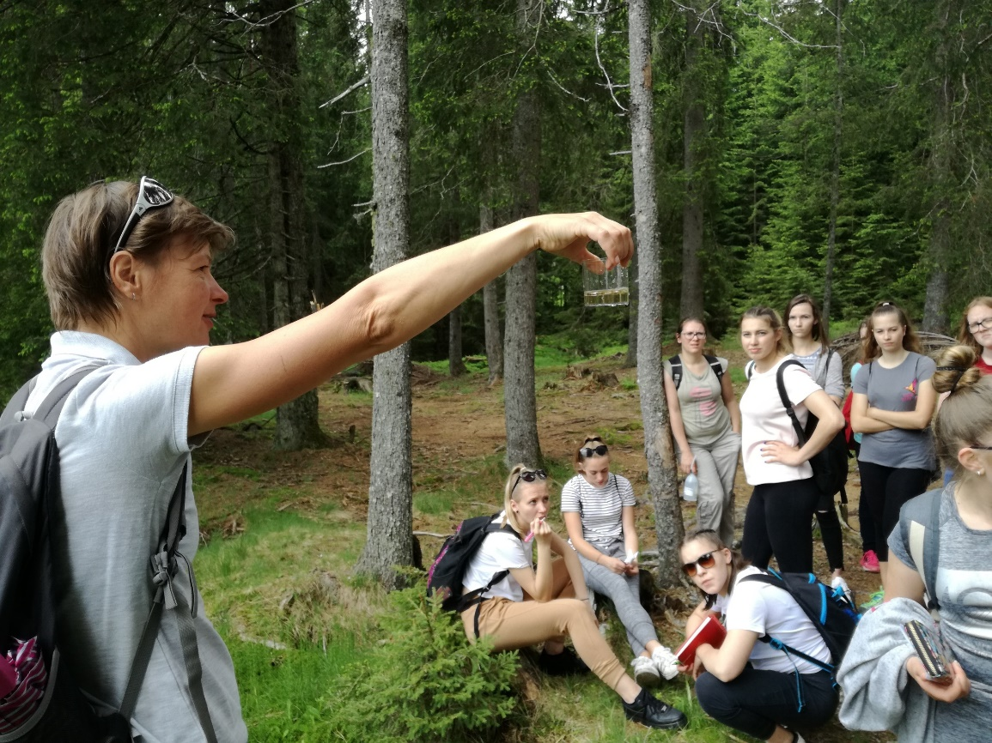
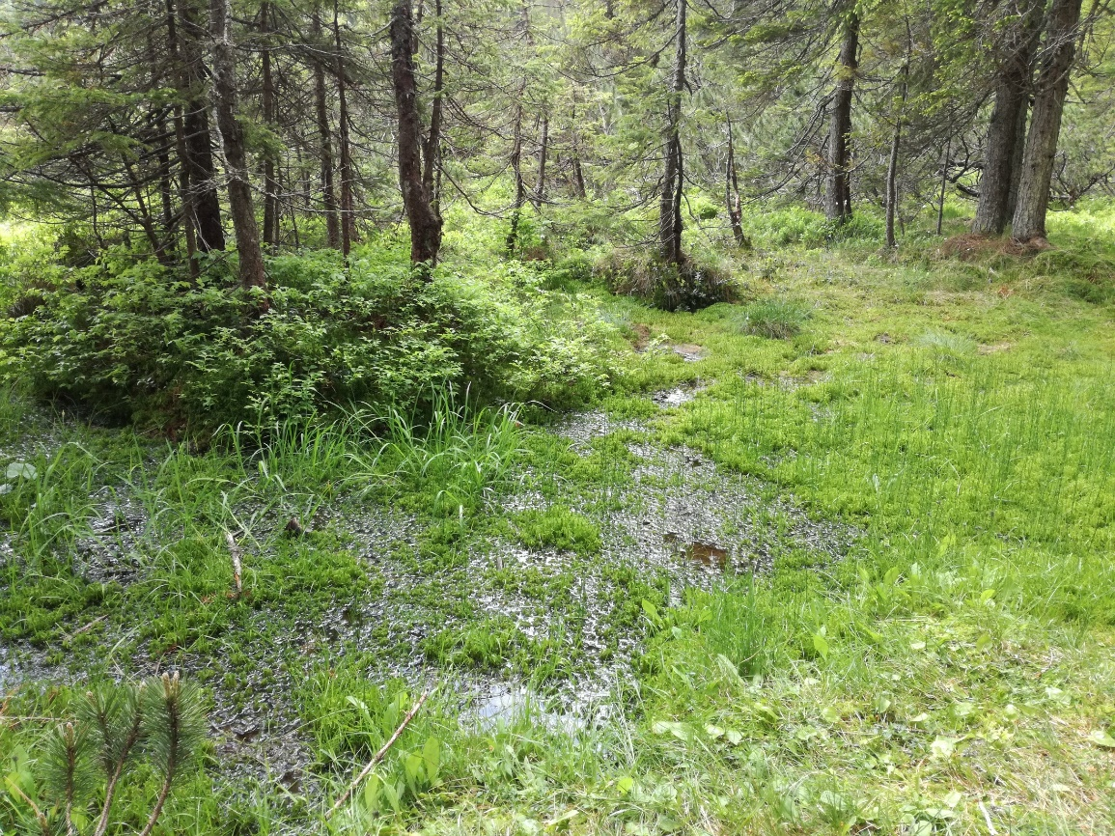
We did on-site analyses of the T, pH, and conductivity of the water taken from the peatbog.
We were observing the colour of the water which was yelow-brownish due to presence of humic acids.

Slide 20
The bog mosses are the predominating species overgrowing the bog surface.

Slide 21
Peatbogs are characterised by acidic soil, low nutrient supply and high differences in temperature.
Plants that grow here are well adapted to these harsh conditions.
For example, species such as the round-leaved sundew Drosera rotundifolia are thrieving in the peatbog. These are carnivorous plants and have developed the ability to trap and eat animals in order to obrain nutrients (especially N and P).

Slide 22
Vaccinium oxycoccos
Eriophorum vaginatum
and
Vaccinium myrtillus
….others – such as heathers - obtain nutrients through their partnership with fungi.
Pokljuka bogs has 7 heather species: common heather, blueberry, cowberry, bog rosemary, wild and small cranberry and bog bilberry.
Vaccinium vitis idaea

Slide 23
We observed various lichens
along the way.

Slide 24
Goreljek Peatbog offers an unique opportunity for learning about peat bogs, its threats and opportunities,
importance of conservation,
education of public,
meaning of sacrifice of certain areas for the purpose of education and research,
and the redirecting of attention of public for the purpose of conservation of other sensitive ecosystems.

Slide 25
Thumb: What was the best part of the pilot activity?
- beauty of the nature around the Goreljek Peatbog
- a person must not walk on peat mosses
- the round-leaved sundew Drosera rotundifolia
- sampling and identification of the benthic invertebrates from the Radovna River
Middle finger: What did you like the least?
- it was boring for local students
- conflict of interest for students who‘s families are also forest owners on Pokljuka Plateau
- too much time was spent for the chemical analyses
- more „action“ – in the sense of more tasks and topics
- filling in the work sheets
- high T and humid weather
Index finger: What will you remember most?
- visiting the Goreljek Peatbog
- spending the day outside in the nature and far from the city
- observing and identifying the animals from the Radovna River
- looking for and seeing the carnivorous plant round-leaved sundew for the first time
- expert from TNP (her knowledge and storytelling)
Our impressions
Ring finger: What touched you the most?
- beauty of the nature
Pinky: What was missing?
- free time to seek for the adventures

