Slide 1
Let’s go to find the alpine plants on mountain pasture Vogar
REPORTAGE OF THE PILOT ACTION
May 30 2018
Teren v TNP v okviru modula Varstvo naravnih vrednot
Mentorja: prof. Marjeta Vovk in prof. Nataša Kunstelj
Zunanja strokovnjaka iz TNP: mag. Tanja Menegalija in Maja Komar Fajdiga

Slide 2
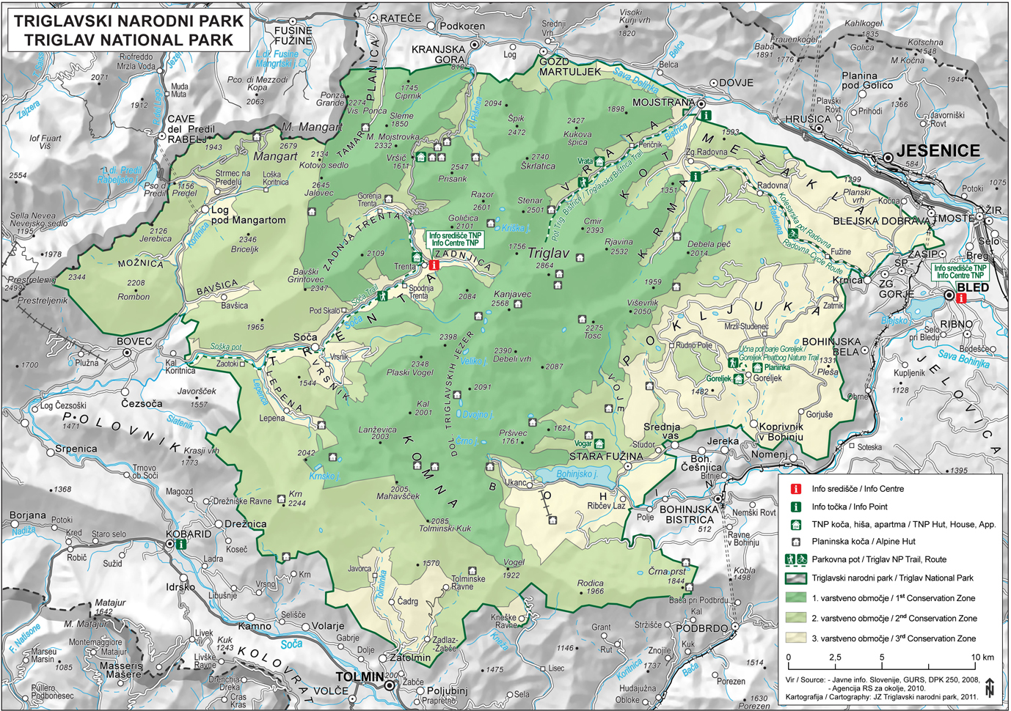
destination of our pilot action on the May 30th 2018
Vogar,
1054 m

Slide 3
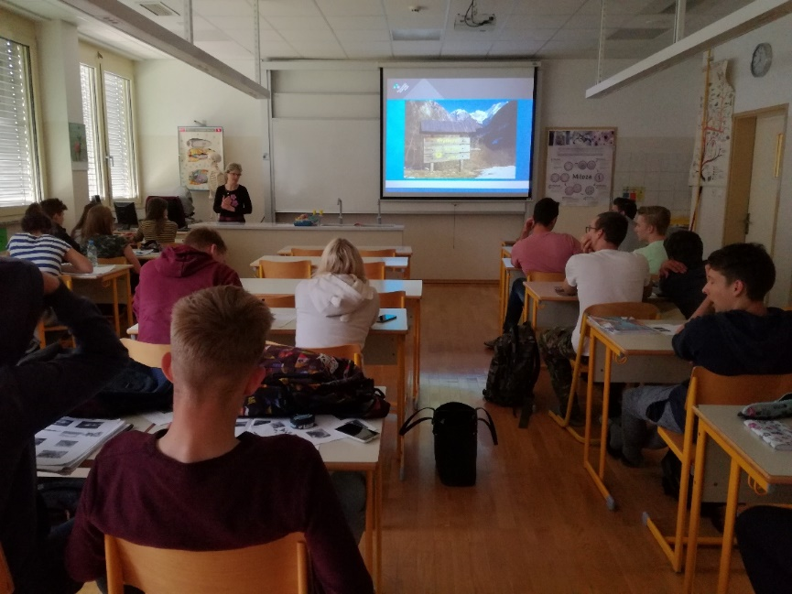
Preparations for the pilot action were taking place throughout the school year within the module Protection of valuable natural features and biodiversity.
We started our pilot action in the classroom with extensive lecture given by expert from Triglav National Park (TNP), Maja Fajdiga Komar, where we learnt about:
phytogeography
alpine ecosytems
alpine climate
altitudal zonation of vegetation
adaptations of alpine plants (morphological and physiological)
nature conservation and environmental legislation in Slovenia through time
effects of anthropogenic activities (mountainering, paragliding,
livestock grazing, forestry)
opportunities and threats
role of education, supervision, and sanctions.
Annex 1, 2 and 3

Slide 4
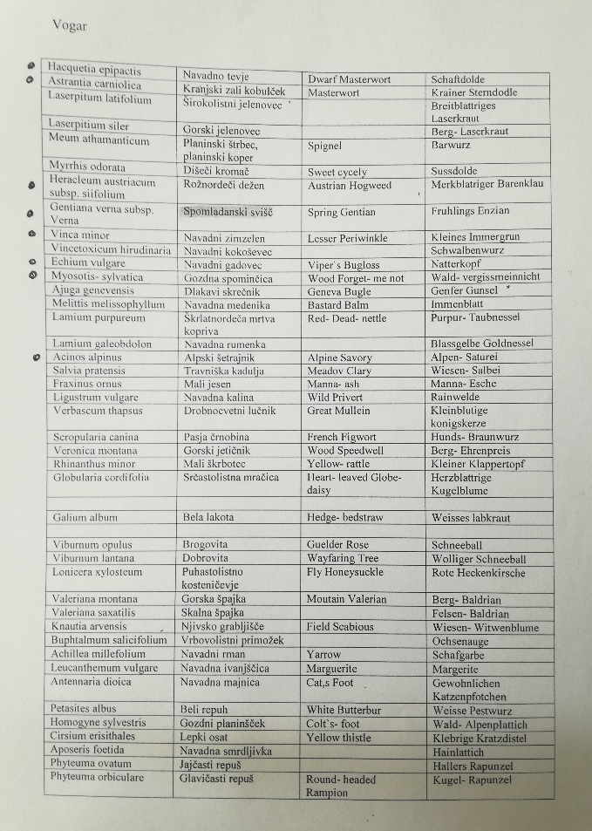
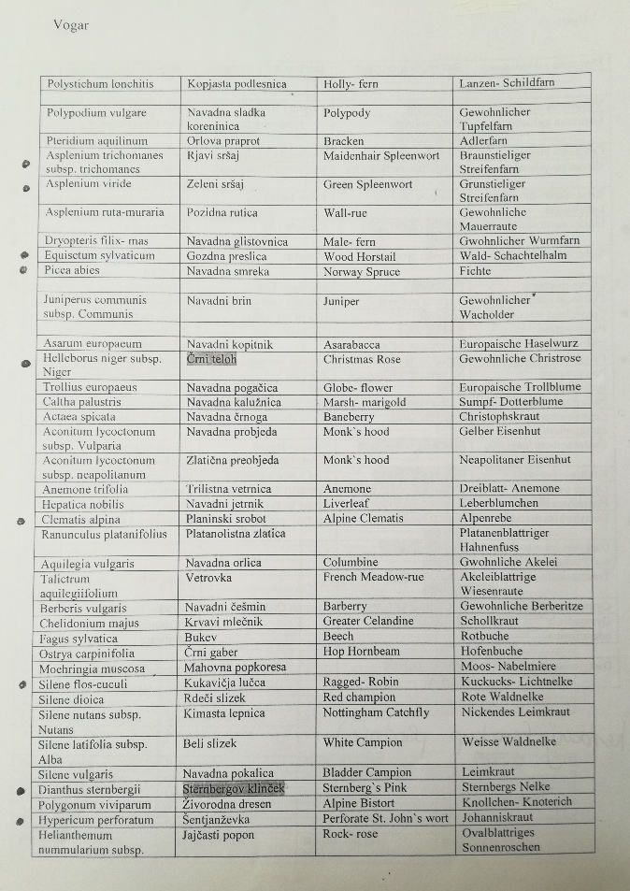
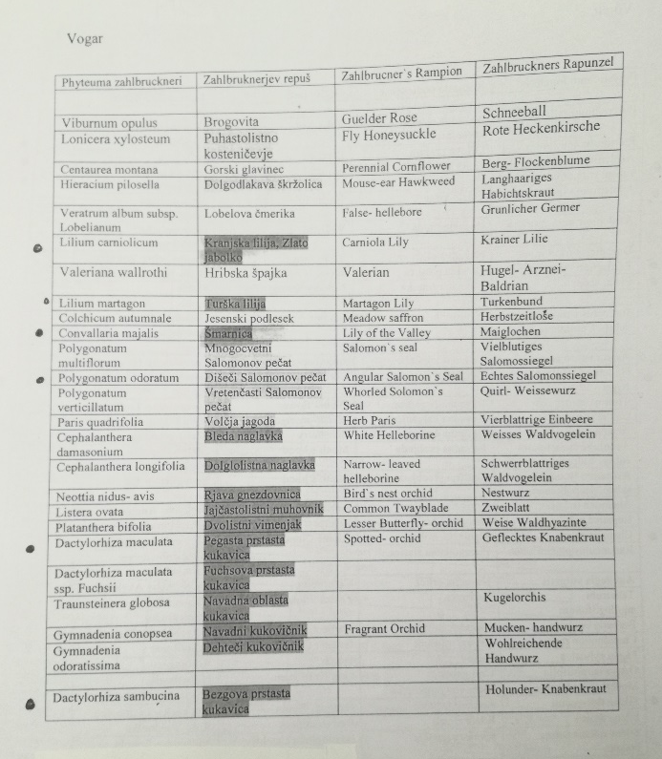
OUR ACTIVITY: Before the actual field-work we got list of the selected alpine plants and had to prepare identity cards for each plant that included:
potograph
Family name
Slovenian and Latin name,
detailed description of the morphology
(roots, stem, leaves, flower, seed, fruit),
habitats,
locations,
special features.
Annex 4

Slide 5
The list of alpine plants us students presented along the hike on Vogar:
Acinos alpinus
Alchemilla xanthochlora
Asplenium trichomanes subsp. trichomanes
Asplenium viride
Erica carnea
Clematis alpina
Convallaria majalis
Cyclamen purpurascens
Dactylorhiza maculata
Dactylorhiza sambucina
Dianthus sternbergii
Echium vulgare
Equisetum sylvaticum
Gentiana verna subsp. verna
Hacquetia epipactis
Helleborus niger subsp. niger
Heracleum austriacum subsp. siifolium
Hypericum perforatum
Lilium carbiolicum
Myosotis sylvatica
Polygonatum odoratum
Silene flos-cuculi
Vaccinium myrtillus
Vinca minor

Slide 6
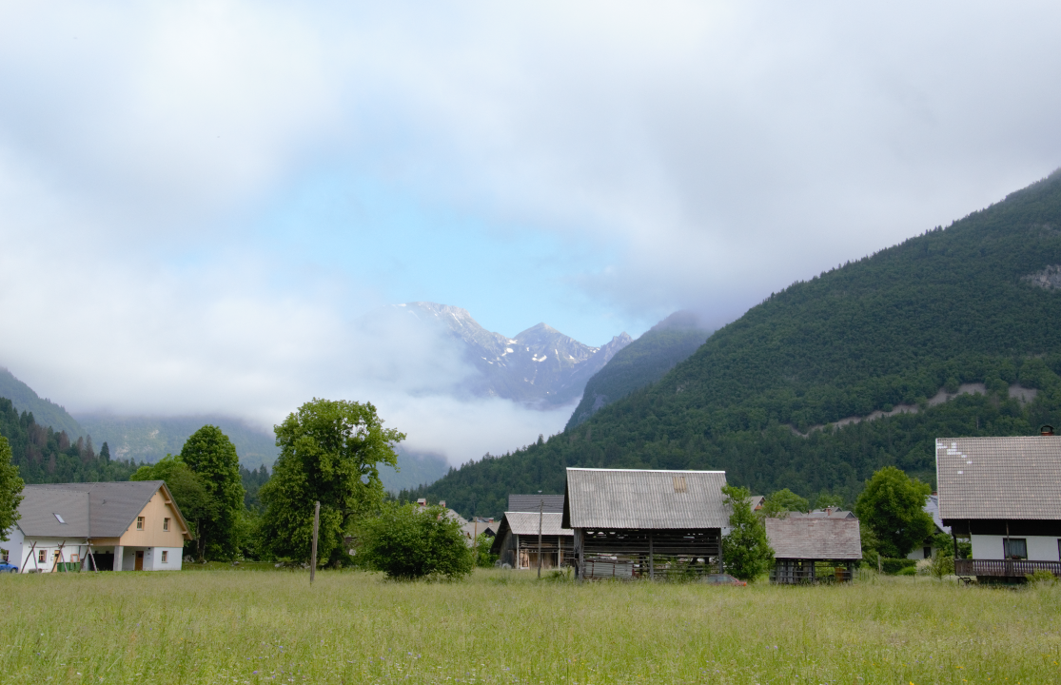
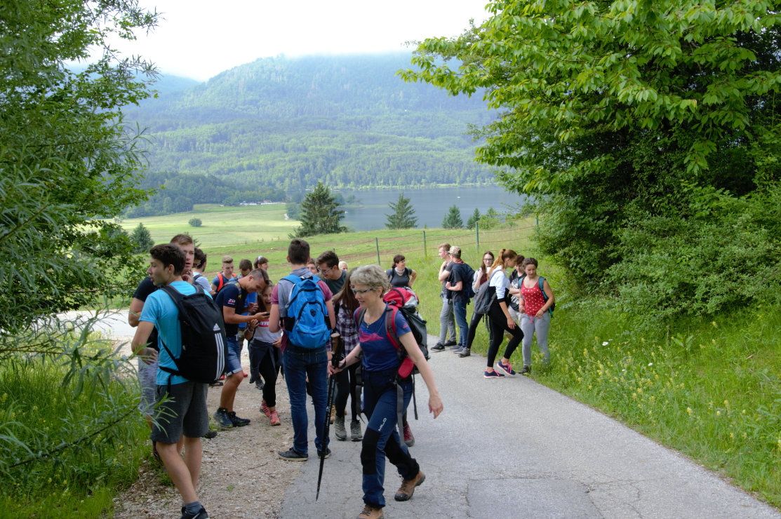
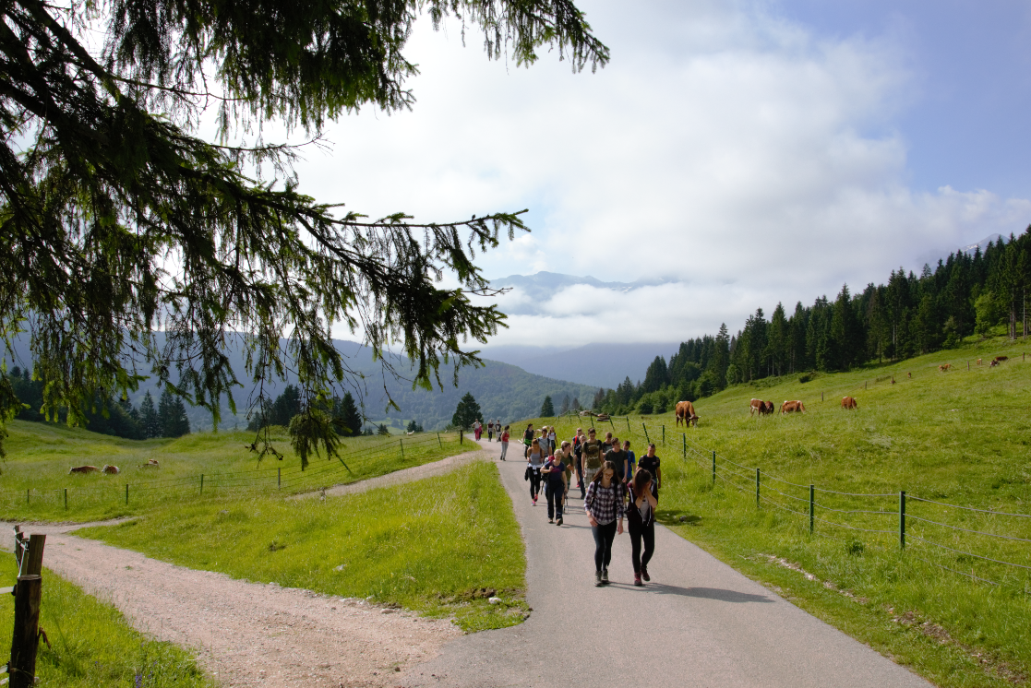
a popular hiking point due to its magnificent views
Vogar, 1054 m
the peak ridge which stands farthest east above the northern shore of Lake Bohinj
We started our hike in Stara Fužina following a marked trail…..

Slide 7
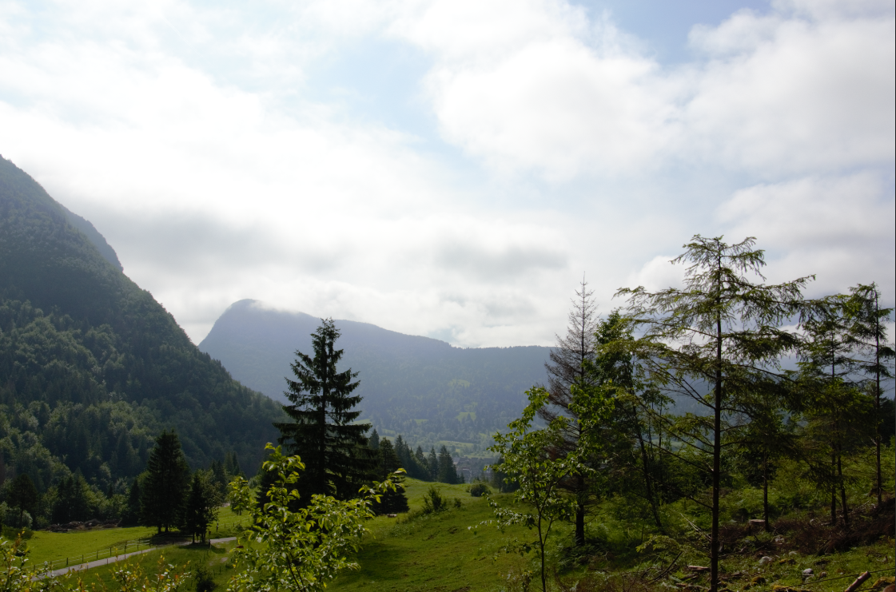
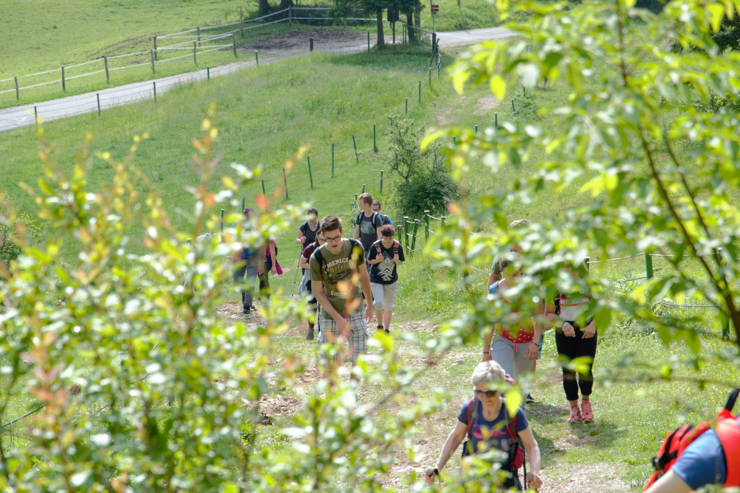
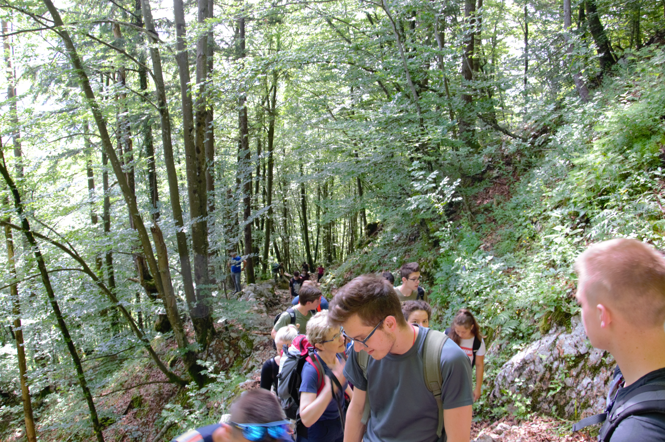
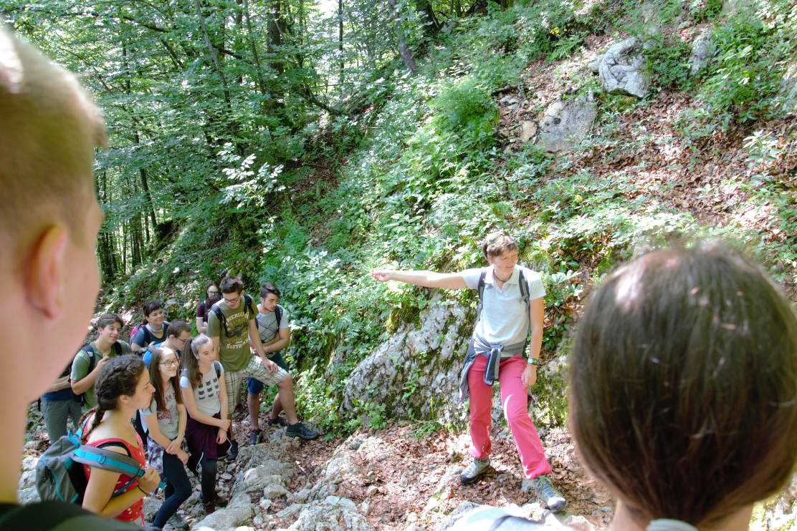
The trail was steep……
……but luckily we had many stops on the way to te top due to observing and identifying the alpine plants ☺.
Two experts from Triglav National Park, Maja Fajdiga Komar and mag. Tanja Menegalija, guided us and made it shure we did not miss a single flower ☺.

Slide 8
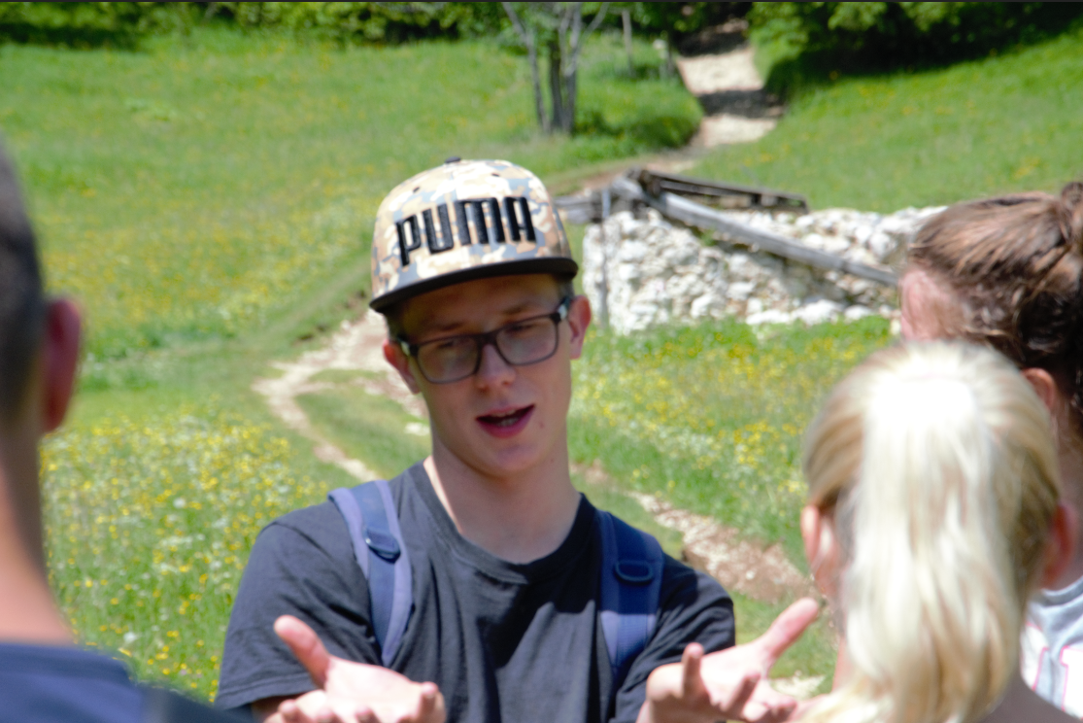
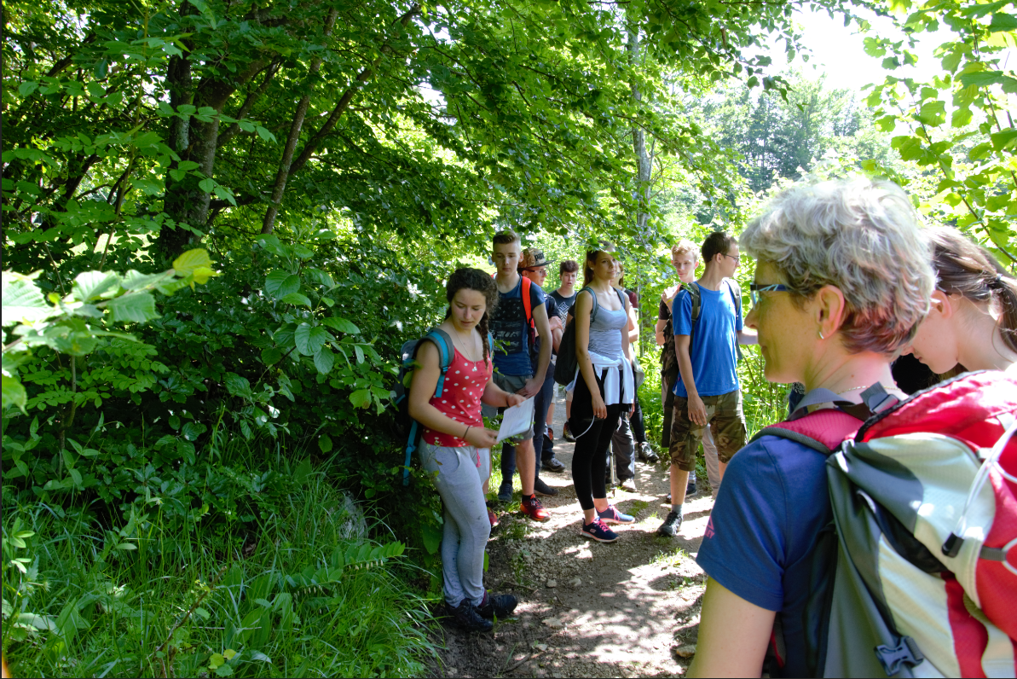
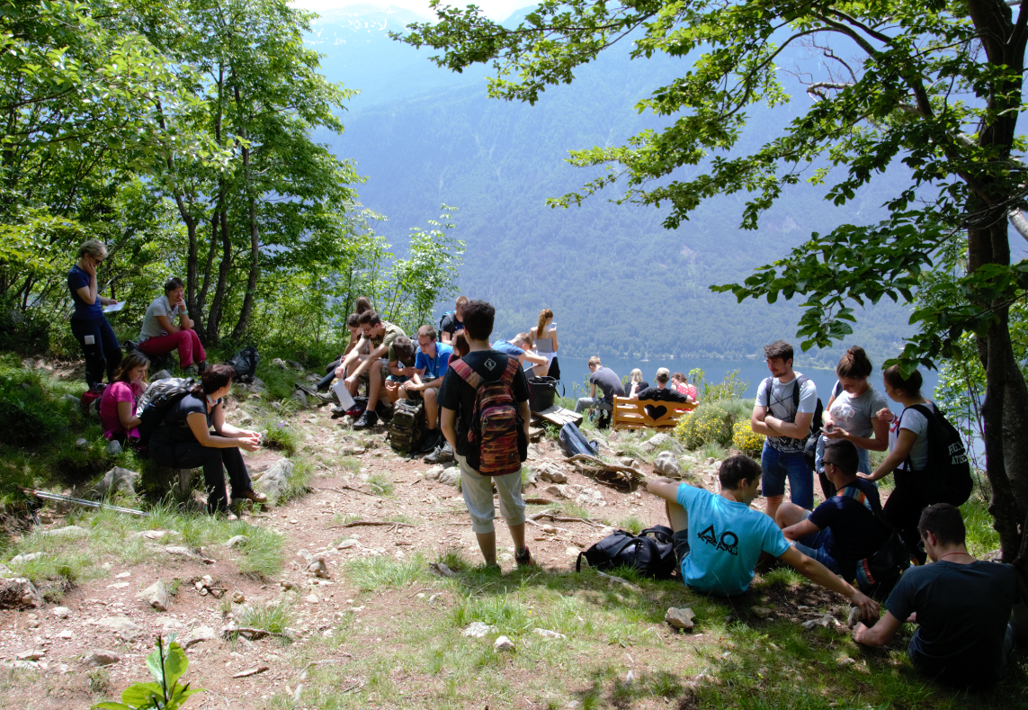
We activelly used our knowledge in the field and participated in the discussion.
Also we got the chance to present the ID card for each plant from our list!

Slide 9
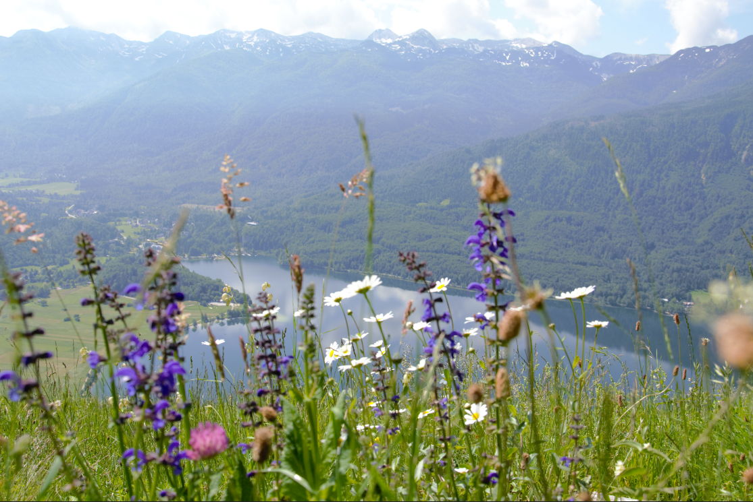
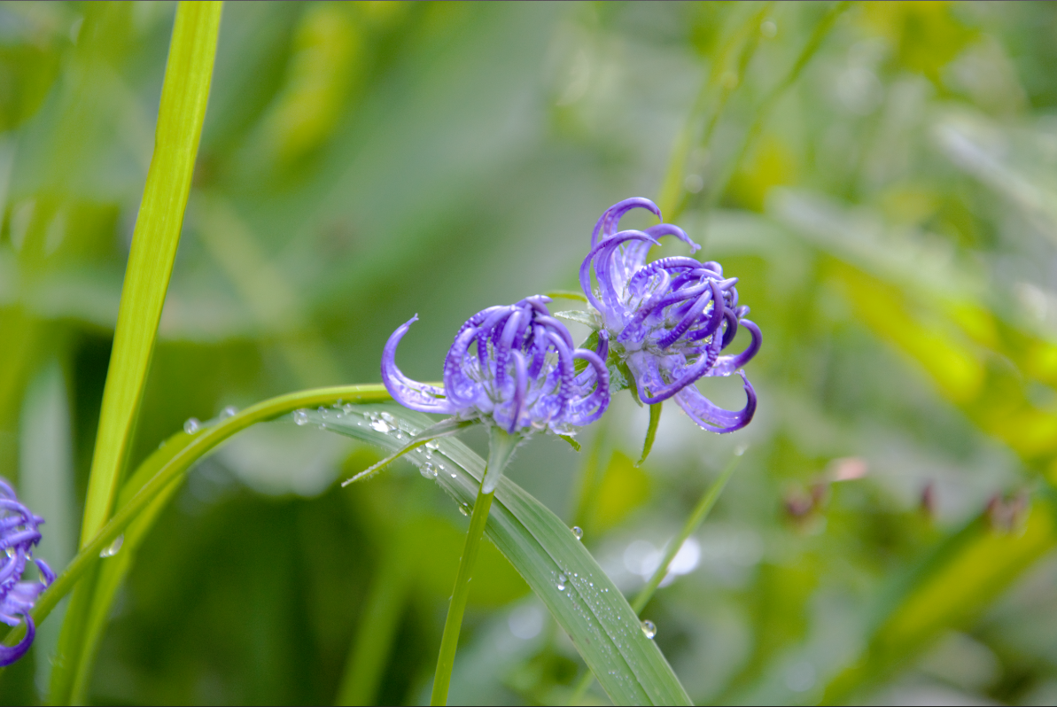
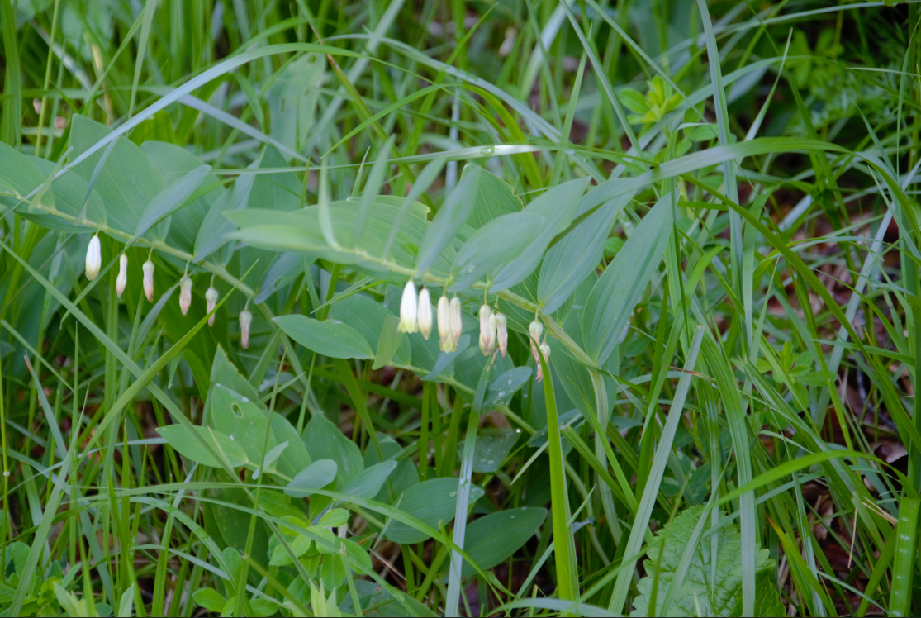
The best shots of the day
Lilium carbiolicum
Phyteuma orbicualre
Colourful meadow on Vogar
Various representatives of Fam. Apiaceae were very common
Polygonatum odoratum

Slide 10
Thumb: What was the best part of the pilot activity?
- Taking photos of alpine flora
- Asplenium trichomanes subsp. trichomanes does not flower
- Birds singing
- Field work
- Vogar and hike
Middle finger: What did you like the least?
- Reading from phones of those who forgot to bring the presentations („ID cards“)of chosen plants
- High T and humid weather
Ring finger: What touched you the most?
- Classmate‘s „hug“ on the bench on Vogar
- Cooperative bus driver
- Beauty of Lilium carbiolicum
- Mountain peace
Our impressions
Index finger: What will you remember most?
- View from the top over the valley and lake
- Alpine flora
- Great company
- Awesome weather
- Well built and marked trail
- Spending school day outside in the nature and learning from experience instead of being in the school and listening to lectures
Pinky: What was missing?
- Swimming suits
- 3 classmates

